Slide 1
Title Substitle
Meeting
Date

Slide 2
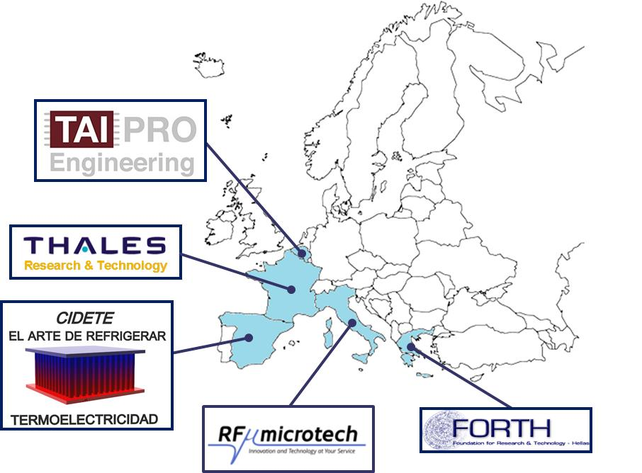
Welcome !
H2020-EIC-FTI-2018-2020

Slide 3
Ex. of Table
A | B | C | D
aaa

Slide 4
Title
Sub-tutle

