Slide 1
First Steps of Pilot’s Business Development WP4 - Actions to establish the Marketing Strategy of the Consortium
FORTH – MANOS TRICHAS

Slide 2
SMARTEC WP4
This WP entails all the actions to establish the Marketing Strategy of the Consortium, including new product “paradigms”. It will cover:
Task 4.2 Market segmentation and appraisal.
Task 4.3 Market needs capture & planning (both products & service offer).
Task 4.4 Go to market strategy including value proposition formulation (allowing positioning the offers) and pricing strategy.
Task 4.5 Leads generation.
Task 4.6 Foreground generation
Task 4.1 Dissemination activities (web site, newsletters, conference presentations etc)
Promotional activities

Slide 3
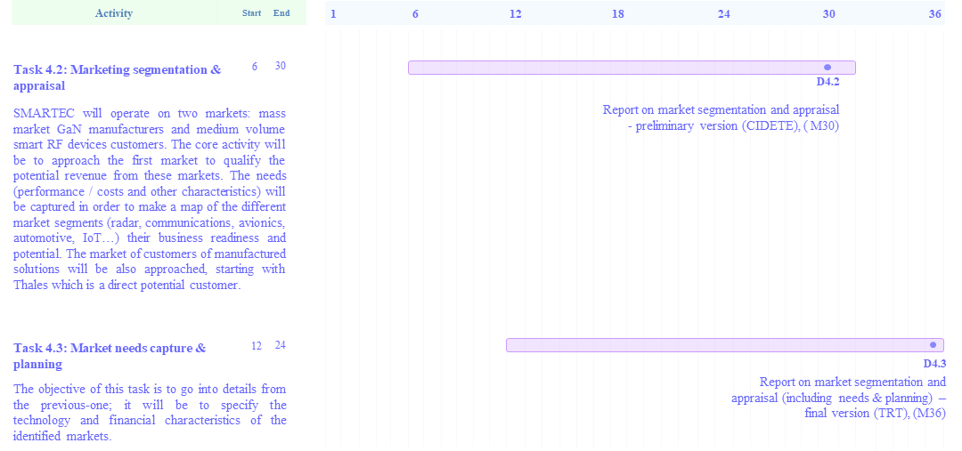
Tasks 4.2 & 4.3 – GANTT Diagram
10

Slide 4
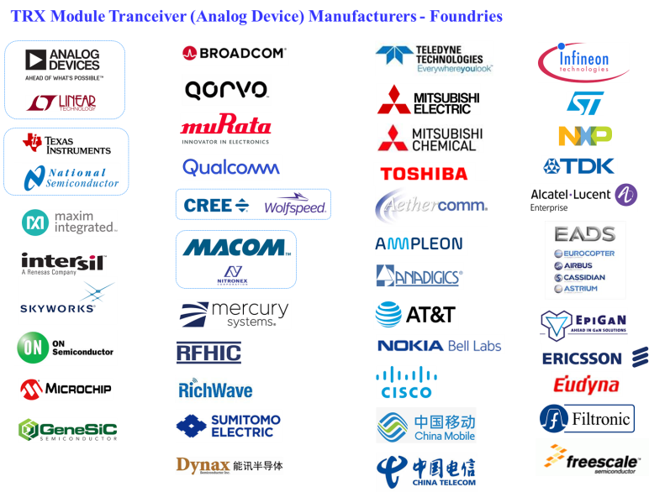
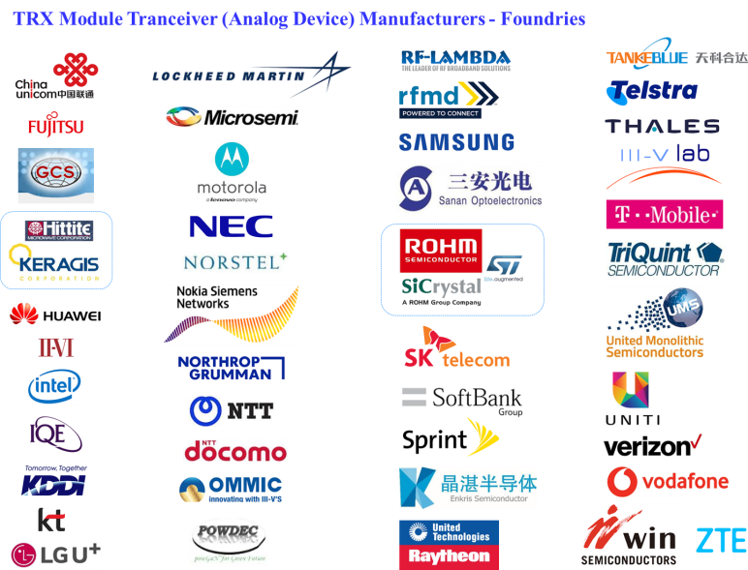
Rivalry Study – The Basis of Marketing Strategy
Study of Rivalry
Set of Old Technologies in equilibrium
WP4: Marketing & Business Development
New Technical
Performances
New Value Propositions & Products
Rivalry
Innovations
Disturb Equilibrium
Competitive
Advantage
Comparison
with Rivalry
Markets
SMARTEC
Degree of Differentiation from the Competition
Markets’ Needs

Slide 5
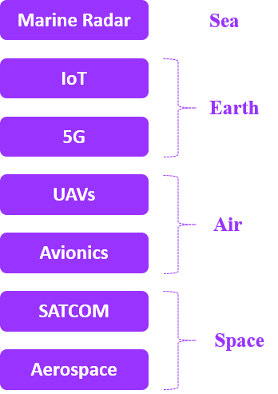
GaN & Non-GaN RF Power Industry Value Chain
Our Suppliers
GaN Chip Manufacturing Rivalry
Our Customers
Applications & Markets
Processing Equipment
Manufacturing
& Design
Capacity
Foundries
IDM
Pure Play
Front-end
Back-end
New Performances
& Products
Commercial Systems Manufacturers
New Value Propositions
Modules
Manufacturers
Measurement & Quality Control Equipment
Costs
Revenues
Subsystems
manufacturers
Revenues
SMARTEC
EDA Tools
Design Houses
Distributor / Traders / Vendors / Dealers
Design Rules
Extraction Models
Intangible Assets
IPs &
Industry Standards
Span across the entire range of industry

Slide 6
Understand the GaN Chip Manufacturing Rivalry
Why ?
Find out SMARTEC’s Competitive Advantage &
How Pilot is going to position itself in Rivalry
Find out who are they and where they sell ?
Understand the dominant Foundry Business Models in the market
Find out their Alliances, Mergers & Acquisitions
Find out their Market Power & Dominant Positions in Specific Markets
Understand their Technology & Product Portfolio
Understand Pilot’s Technological Competitive Advantage over rivalry
→ How Different we are… .
Do we need their technology to commercialize ours?
Do we need anyone to become a Strategic Partner?

Slide 7
What we have done already ?

Slide 8
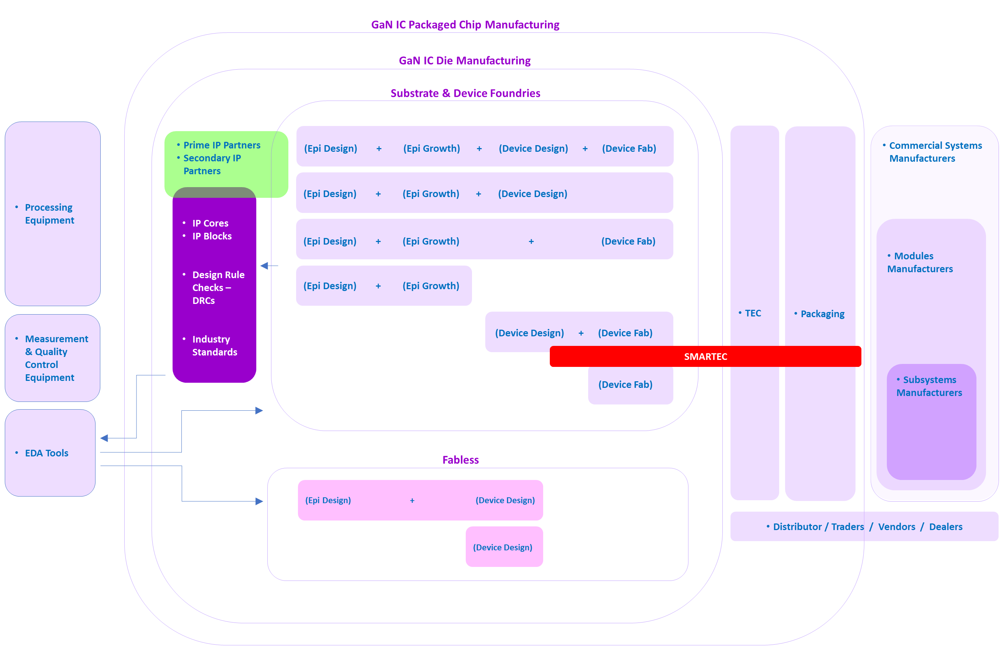
Start understanding GaN & Non-GaN RF Power Industry Value Chain
Is “TEC’s integration in the Package” an Innovation in the Industry?
New Inventive Step ?
New Patent ?

Slide 9
Understanding Semiconductor Industry Business Models
Integrated Device Manufacturers (IDMs)
(they produce their own products)
“Pure-Play” Foundries
“Fabless – Foundry” Alliance Model
Fabless

Slide 10
Understanding Semiconductor Industry Business Models
“Front-End” Technology = the separation of Design & Manufacturing
“Back-End” Technology
= (Assembly & Testing)
Who is going to do the TESTING of the packaged TRX Module ?
Will affect Pilot’s Revenues

Slide 11
Testing
SMARTEC Project
Non – Packaged TRX →
Packaged TRX →
Post-SMARTEC
Who is going to do the Testing ?
How is he going to charge ?
Prototyping
In house facility
COSTS …
Outsourcing

Slide 12
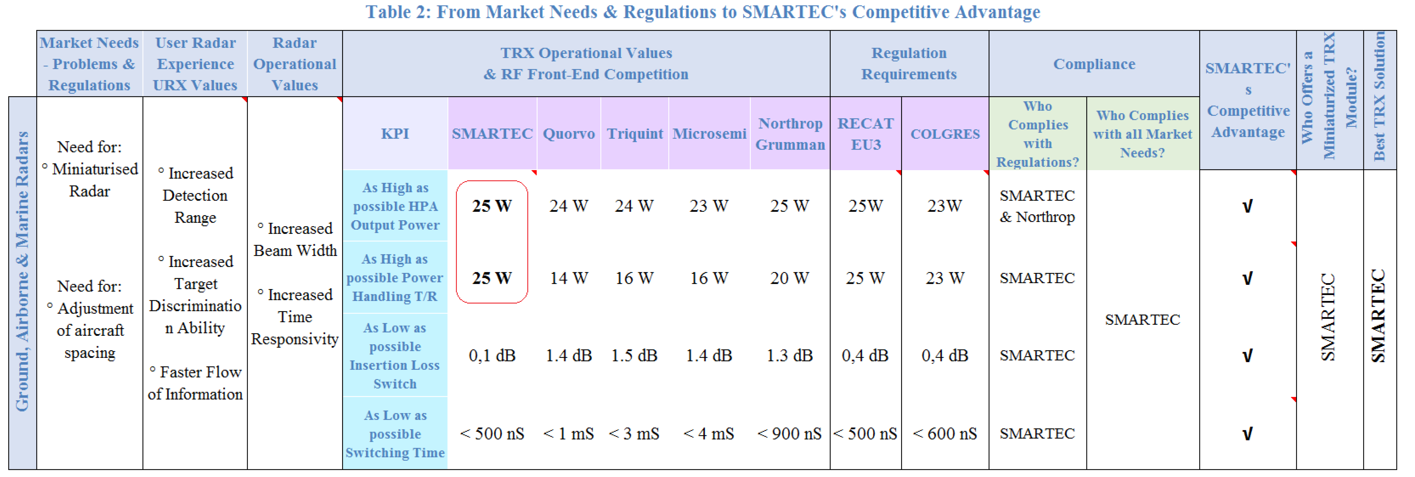
The Importance of IP – Started tracing out Competing Products
Started recently

Slide 13
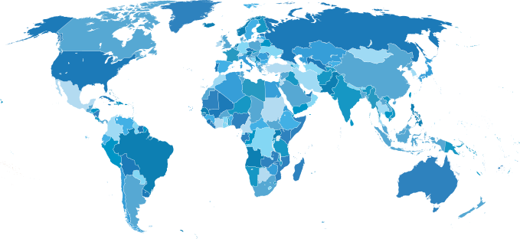
Global Mapping of our Rivalry
Started recently
European Actors
US Actors
Alliances – Mergers - Acquisitions
Cluster
Asian Actors

Slide 14
Study the IP Landscape for Rivalry Technology Monitoring & Understand Our Inventive Steps
(Pilot’s Outer World)
SMARTEC Partners
Assigned to Patent Attorneys
IP Landscape Study
(Prior Art Study)
Freedom – to – Operate
Patent Litigation Risk Study
Derive the best possible information to feed the patent attorney
Draft Patent(s)
Patent Applicants must :
1) know very well Patent & Non-Patent Literature
2) Have a good idea of what their Inventive Steps are…
3) True IP Ownership…
(HPA + LNA + RF-MEMS Switch)
SMARTEC IP Portfolio Formation
Patent Filings &
Trace Standard Essential Patents
Licensings
(eg. TEC Integrated in Package)

Slide 15
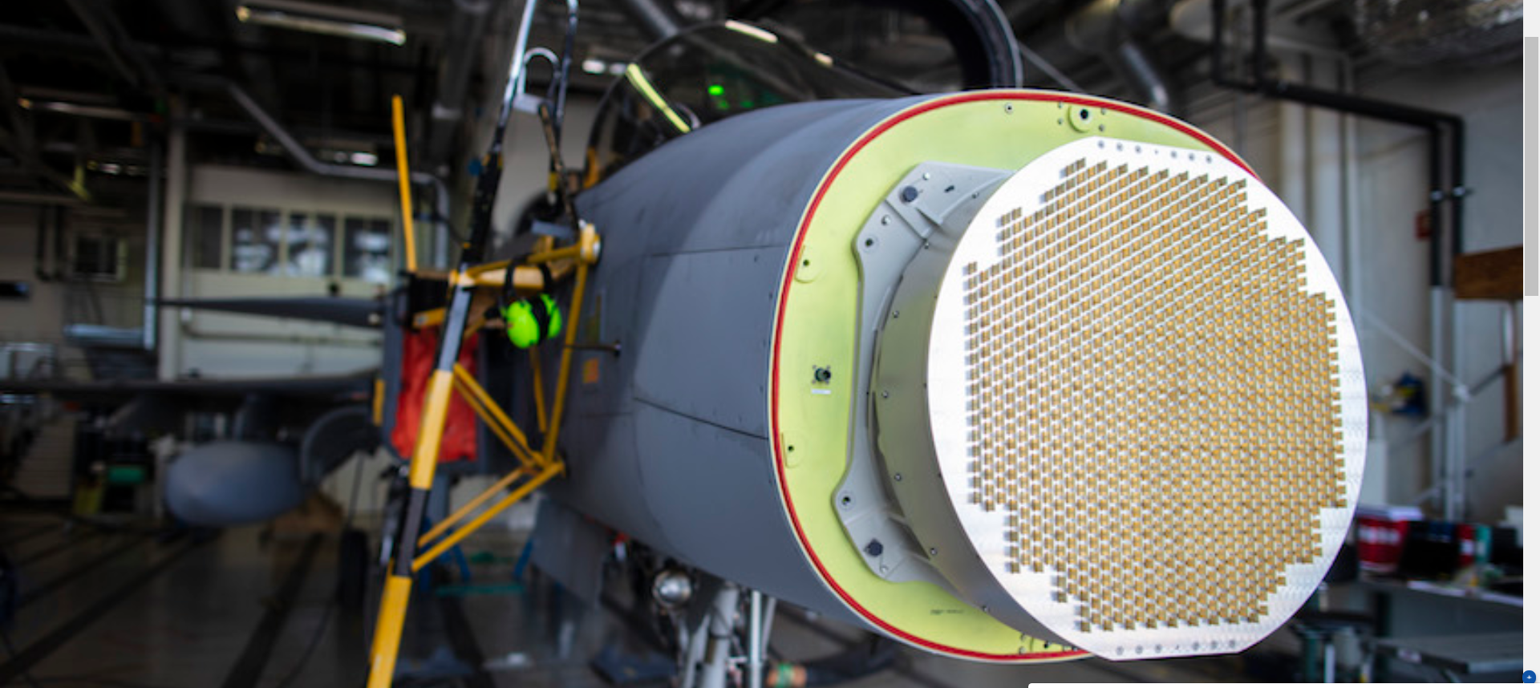
Search for Patents & Classification
Over 200 – Legal Entities
in the RF / Power Industry
Many others do not have have GaN Patents
Some do not have GaN Patents by use GaN Tech
Saab - Ericsson
91 have GaN Patents
GaN MMICs
RF MEMS
Low Noise Amplifier
High Power Amplifier
Transistor
Coplanar
Monolithic
Vias
Back-End
Microwave
RF Power
Switch
Transceiver
Integrated Chip
Package
Technology Portfolio of Competitiors
Direct Threatening our Inventive Step(s)
Sources of New Ideas → Future Products
Sources of Licensing
Irrelevant
Classification
In Progress
> 4000 Patents
Study them
EPO
US
WO
Translations Problems
TW
KR
CN
JP

Slide 16
What we need to Discuss ?
SMARTEC Project
Technology Transfer together
“Inventive Steps” – TEC ?
Industry Standards we need to adopt
Patent Filing(s)
Post-SMARTEC
“Who sells to Whom” issues
How Patent Filings, Technology Transfers, Standard Adoptions & Testing Service affect Pilot’s Cost Structure & Profits of Margin.

Slide 17
Our Product as an IP & Technology Transfer Input Set
TEC
PACKAGING
HPA
MEMS Switch
LNA
HEMT Structure

Slide 18
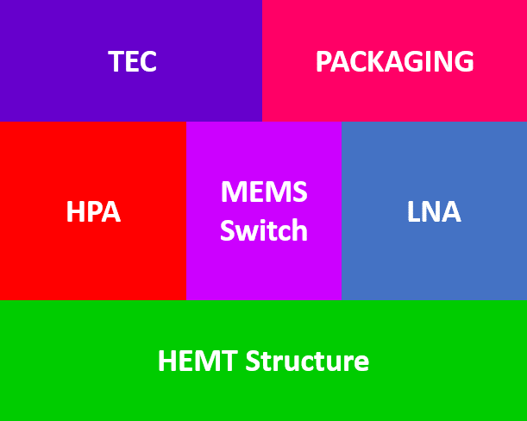
Our Product as a “Set of Inventive Steps”
Inventive Step = The actual (protected and defined in the patent claims) technology, that solves a technical problem.
The technology could be:
for the moment:
Complete Secrecy is Needed
a Product or
a Method or
a Use
Talk to Nobody without thinking what you are revealing
No Youtube videos,
No Announcements in SMARTEC’s Website
No Announcements in Conferences etc
So far, our Inventive Step is:
The Combination of the HPA, LNA & MEMS Switch on the same substrate.
Many Technical Parts of the Assembly are not yet known…
Do we have any other Inventive Steps ?
…meaning other patents ?
These are Disclosures of Sensitive Information that
Destroy the Novelty
of our Inventive Steps their
Patent Applicants ?
(ex.: The Fabrication Method of our TRX Module)
(ex.: A New Packaging Design as a standalone product)
(ex.: A New TEC Design as a standalone product)
(ex.: The Encapsulation Method of the TRX Module & TEC in the Packaging)
Patent Applicants ?
No Patents

Slide 19
Technology Transfer according to Proposal
IPs ?
IPs ?

Slide 20
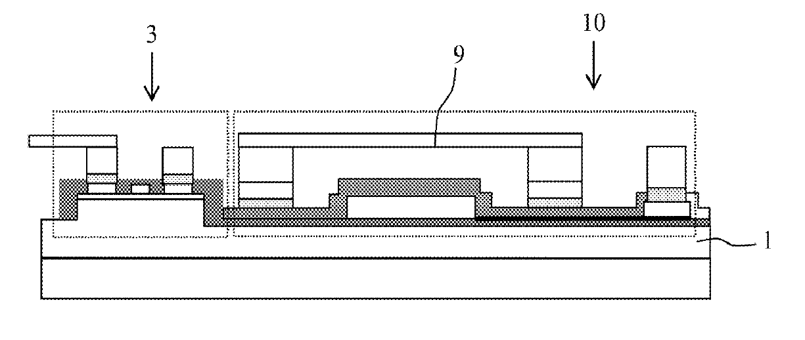
Patent Portfolio
US2013056751A1
Priority Year: 2009
Method for Integrating MEMS Microswitches on GaN Substrates Comprising Electronic Power Components
Patent granted
Technology Transfer to
Needed as soon as possible

Slide 21
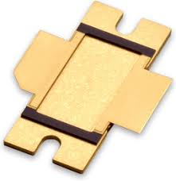
Packaging Standards – The most important ones
Ensure Interoperability → Market Diffusion of our Product
Package Technology Evolution
SOP
SOJ
SSOP
TSOP
SOP
Which Technology is right for SMARTEC TRX Module?
Do we need to invent our own Package Technology (new inventive step) ?
What Standards are needed to exhibit interoperability ?
(Especially for RADARS)
DIP
Skinny DIP
Shrink DIP
QFA
QFP
TCP
Stacked Package
BGA
BGA / LGA
CSP
WLP
FCIP
SiP
FCIP

Slide 22
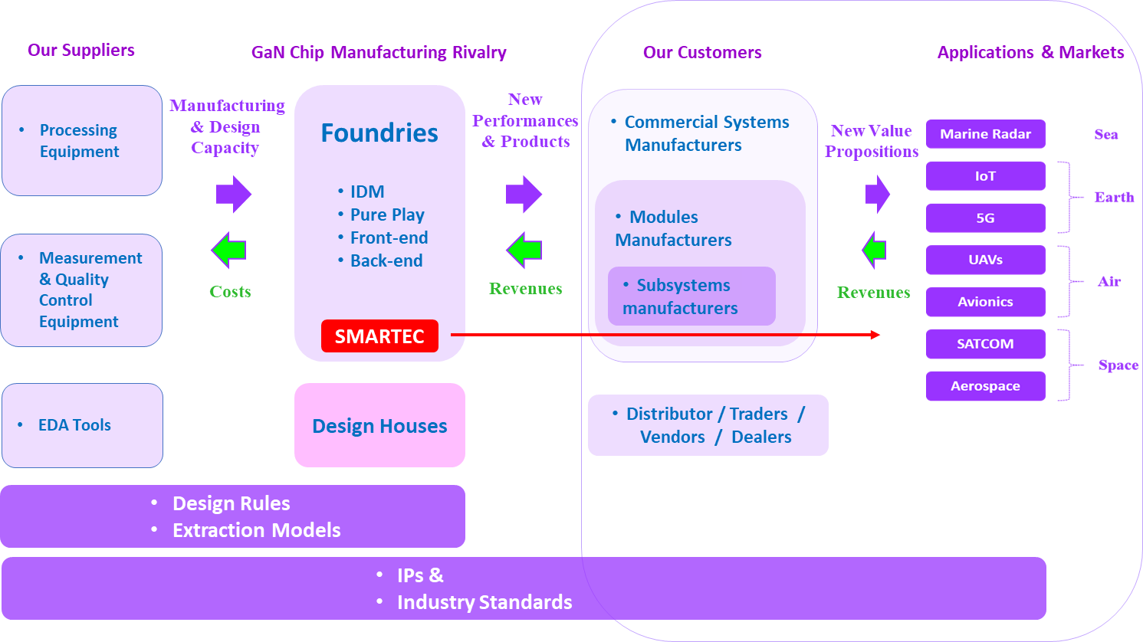
Help from SMARTEC Partners is needed in …
Understanding what are the Electronic Components (of the RF Power & Microwave Product Tree
Finding out the a big number of Actors in Subsystems, Modules & Commercial Systems Manufacturing
Tracing Industry Standards (at least for RADARs)
Across all Targeted Markets

Slide 23
Focus Actions for better Marketing Strategy
Task 4.2 Market segmentation and appraisal.
Task 4.3 Market needs capture & planning (both products & service offer).
Task 4.4 Go to market strategy including value proposition formulation (allowing positioning the offers) and pricing strategy.
Task 4.5 Leads generation.
Business Networking
Networking Costs
Traveling Expenses
Participations Fees
Networking Fees
Promotional Expenses
Exhibitions - Trade Fairs
Technology Marketplaces
Brokerage Events
Direct contact with Real Market Actors
Customer Discovery & Validation
Learn Real Market & Customer Needs
Attract Investors
Optimize Value Propositions
Recruit Personnel
Prototype Demonstration

Slide 24
A Project Management Problem

Slide 25
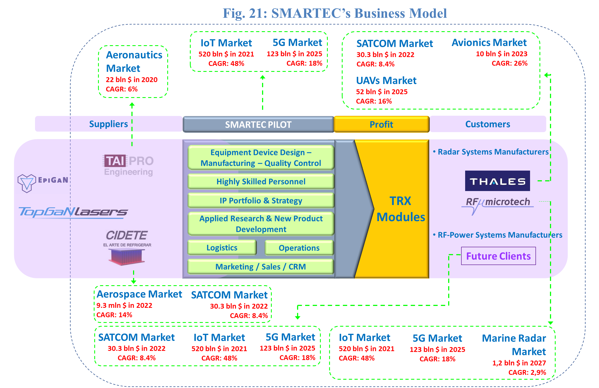
SMARTEC’s Business Model according to Proposal

Slide 26
Task 4.2: Marketing segmentation & appraisal
GaN RF Power Industry Value Chain
New Performances
RF Power & Microwave
Product Tree
SMARTEC
MS 4.3 → M12
Pilot Preliminary marketing strategy assessment
Applications & Markets
Competitors
vs
New Value Propositions
Task 4.3: Market needs capture & planning
( M12 – M24 )
Task 4.4: Go-to-Market strategy
( M24 – M36 )

Slide 27
Milestones of M12 - WP4
MS 4.1:
Pilot line and Ind. Partners 1st revised business plans
September
An updated vision of the exploitation plans is produced in a Vision Document.
What about CIDETE, TAIPRO, RFM & Thales Exploitation plans ?
??
Too early for that. I haven’t even started studying the pilot’s targeted markets (5G & IoT)
MS 4.3:
Pilot Preliminary marketing strategy assessment
Marketing strategy reviewed by external resource & provision of recommendation.
Who wrote that ?
Must we assign this to an external firm?

Slide 28
Milestone MS 4.3
Pilot Preliminary marketing strategy assessment
External Assessor ??
Pilot’s targeted markets
Marine Radar
Sea
Serious input from RFM & Thales needed
IoT
SMARTEC
Earth
I started working on that, but needs time beyond M12 to deliver a basic preliminary marketing strategy… .
5G
UAVs
Air
Serious input from Thales needed
Avionics
Real close business collaboration with Thales & RFM to draft the preliminary Marketing Strategy Study and begin the real business collaboration

Slide 29
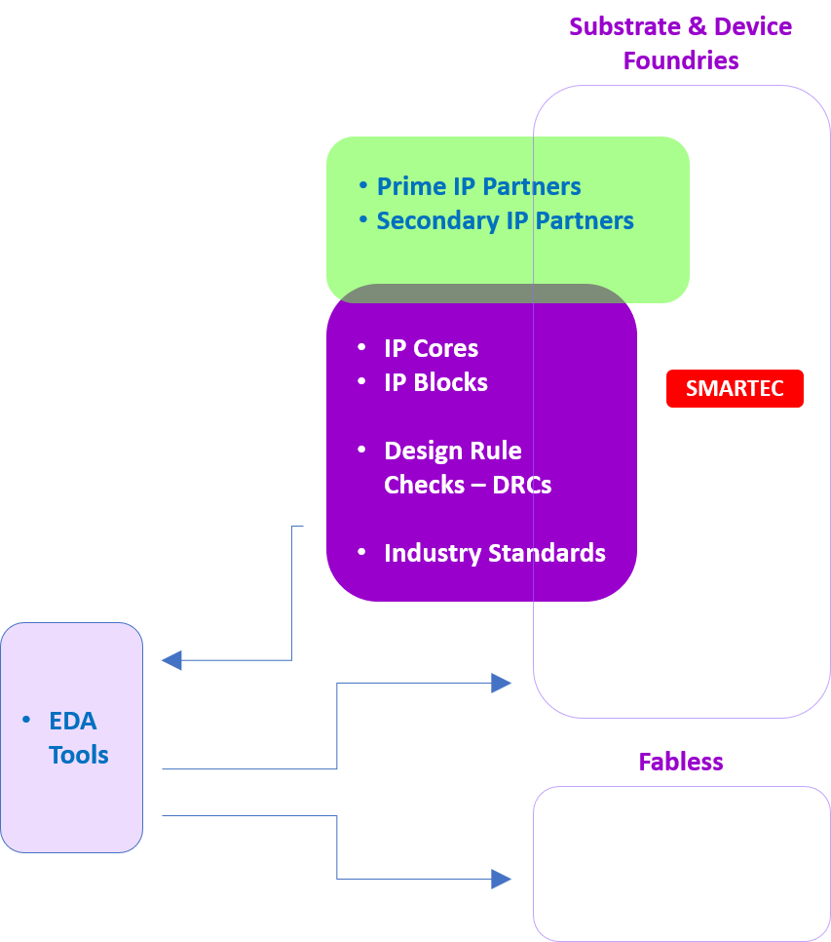
Post-SMARTEC Non-Linear Extraction Model – a quasi Industry Standard
Helps Market Diffusion of our Product
Angelov Model
properly extracted nonlinear model
Scientifically Verified &
Broadly Accepted in the Industry
Extraction Models
of GaN Devices

Slide 30
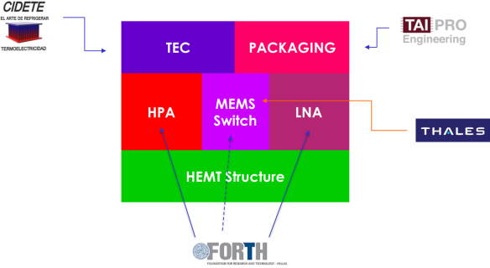
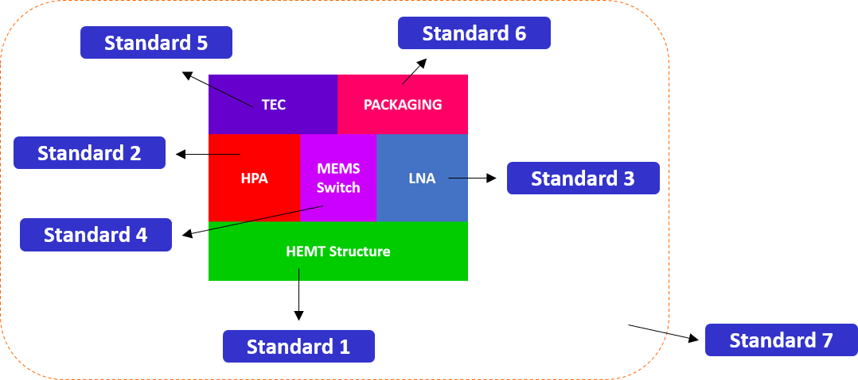
Post-SMARTEC: IP, Tech Transfer & Standards & Business Model affect “Who Sells to Whom” & Profit Margins
IP & Technology Transfer Input Set
Industry Standards Input Set
IPs & Standards
SMARTEC
Business Model 1
Products
Inputs
Customers
Certification Costs
Revenues
& Licensing Fees
IPs & Standards
SMARTEC
Business Model 2
Products
Inputs
Customers
Certification Costs
Revenues
& Licensing Fees
Agreements
& Costs
Agreements
& Costs

Slide 31
Investment (or Costs) Trade-off in Tangible & Intangible Assets
SMARTEC
Intangible
Tangible
Post-SMARTEC
Freedom – to - Operate
Equipment for Pilot Manufacturing Capacity
Patent Litigation
Shall Applicants share Expenses ?
Equipment for Increased Manufacturing Capacity
Licensor Search
Patent(s) Drafting
in order to become “Pure-Play” Foundry
GaN RF Power Engineers
Patent(s) Filing
Standard(s) Certification
in order to redesign the HPA & LNA
Tech Transfers to Pilot
Does it worth spending in Tangible Assets, while Intangible ones are weak?
Extraction Models
of GaN ICs
€ - Where can we find it ?
when Patent Search Reports give X, Y
Who is going to be our Patent Attorney ?
Who is going to deal with the Technology Transfer Agreements ?

Slide 32
Post-SMARTEC “Who does What” – “Who Sells to Whom” - Shippings
Costs & Insurances
Sells TECs
Pilot
Packaging Service (& Testing ?) Cost
Revenue
(Price ?)
Sells Packaging (& Testing ?) Service
Sells Substrates
Sells Packaged TRX Modules
Revenue
(Price ?)
Revenues
Questions
Is this an acceptable post-SMARTEC model?
What is shipped to whom?
Cidete ships its TECs to Pilot or to Taipro?
Pilot ships its TRX dies to Cidete or to Taipro?
Packaged TRX modules are shipped to Thales/RFM by Taipro or by Pilot (the actual seller?)
How do these transactions correlate with technology transfers agreements?
Payment directions ≠ Shipping Directions
Payment Methods – Documentations - ISO

Slide 33
A Request to
all Partners
for
Long Term Commitment
For Business

Slide 34
What are the Business Contacts from each Partner ?
Manos TRICHAS – PhD, MBEcon
8
Innovation Manager
manos.trichas@iesl.forth.gr
trichas.manos@gmail.com
????
????
????
????

Slide 35
Thank you for your attention
Merci de votre attention
Gracias por su atención
Grazie per l'attenzione
Σας ευχαριστώ για την προσοχή σας
Questions ?
Dr. Manos TRICHAS
8
Innovation Manager
manos.trichas@iesl.forth.gr
trichas.manos@gmail.com
35

