Slide 1
Project overview
Review Meeting Y1

Slide 2
Outline
Consortium & Project Overview
SMARTEC Concept & Objectives
Project Organization & Management Structure
Highlights and overall achievements of each work package

Slide 3
Outline
Consortium & Project Overview
SMARTEC Concept & Objectives
Project Organization & Management Structure
Highlights and overall achievements of each work package

Slide 4
Administrative status
SMARTEC
  Pilot Line Production of Transceiver Modules for Next the Generation of Smart RF Power Applications
Project number
  869817
Project Officer (EC)
  Linda CURZOLA
Work program topics addressed :
  H2020-EIC-FTI-2018-2020 ➔ Fast Track to Innovation
Budget
  3,65 M€
Duration of 3 years and the starting project (T₀) on 2019 September 1st

Slide 5

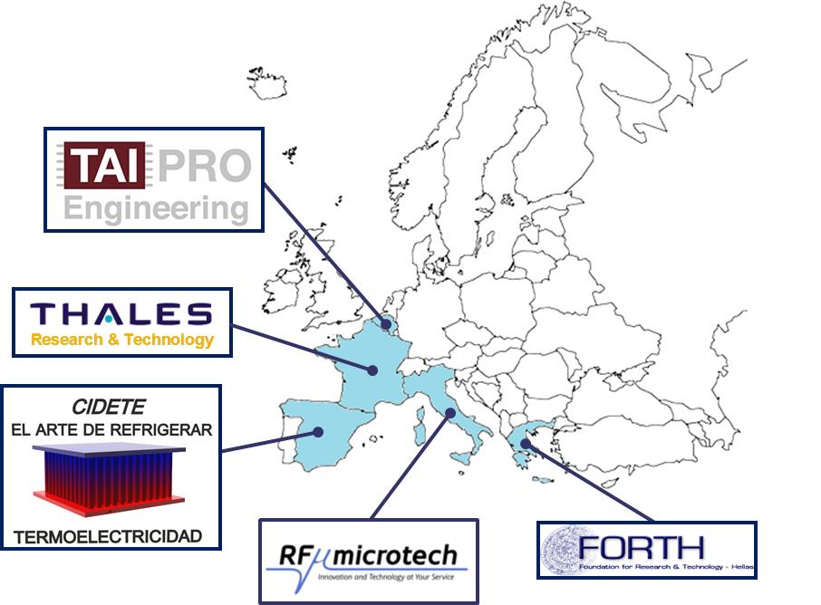

Consortium
n° | Participant legal name | Country
1 | THALES SA (THALES) | FR
2 | CIDETE INGENIEROS SL (CIDETE) | SP
3 | RF MICROTECH SRL (RFM) | IT
4 | FOUNDATION FOR RESEARCH AND TECHNOLOGY HELLAS (FORTH) | EL
5 | TAIPRO ENGINEERING SA (TAIPRO) | B
H2020-EIC-FTI-2018-2020

Slide 6
Outline
Consortium & Project Overview
SMARTEC Concept & Objectives
Project Organization & Management Structure
Highlights and overall achievements of each work package

Slide 7





  SMARTEC Concept & Objectives
Pilot line for TRX modules
  Monolithic integration GaN MMIC (HPA, LNA, RF-MEMS)
  Coplanar technology ➔ MEMS integration
  TEC integration & Packaging (SiP)
  2 radar applications addressed : Avionic Radar (THALES) & Marine Radar (RFM)
TRL6
TRL8
Reconfigurable
RF modules
(HPA, LNA, RF-MEMS)
PILOT LINE
For
TRX MODULES
PROTOTYPING
&
MANUFACTURING
Thermoelectric Cooling Modules (TECs)
RF Systems validation
(In real condition working)
MARINE & AVIONICS
RADAR PROTOTYPES
RF Packaging

Slide 8
  SMARTEC Concept & Objectives
SMARTEC
RF Markets
Fill a gap in the European landscape of power RF manufactures
Help European firms using power RF front ends compete global players
Pilot Line for
New RF power modules
Enhanced performance
Smaller size
Low cost manufacturing
need of higher power, higher frequency at ever decreasing size, volume and cost

Slide 9
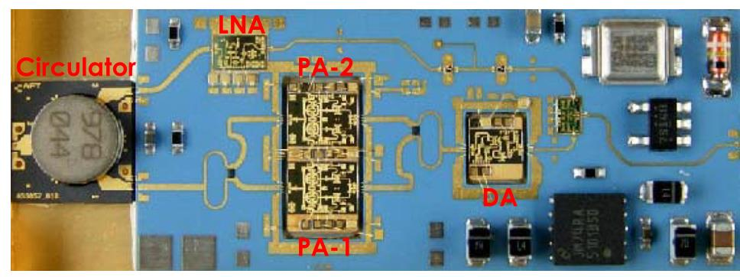
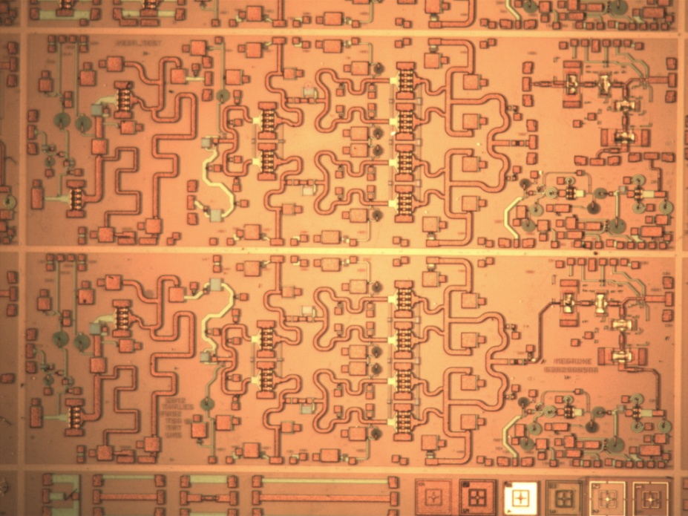
SMARTEC Concept & Objectives
Monolithic Integration (HPA/LNA/RF-MEMS)
  On GaN for high power needs ➔ reliability
  RF-MEMS switches for RF signal reconfiguration
25 mm
Costs/sizes reduction
Enhanced performances
10 mm
9 mm
Monolithic Integration
3 mm
RF MEMS switches compatible with MMIC GaN technology
➔ alternative to ferrite circulator/circulator
➔ Higher integration in CPW configuration

Slide 10





SMARTEC Concept & Objectives
Background on monolithic integration
Nanostructured materials and RF-MEMS RFIC/MMIC technologies for
highly adaptive and reliable RF systems
Micro and Nano Technologies Based on Wide Band Gap Materials for Future Transmitting Receiving and Sensing Systems
Reconfigurable Microsystem Based on Wide Band Gap Materials, Miniaturized and Nanostructured RF-MEMS

Slide 11
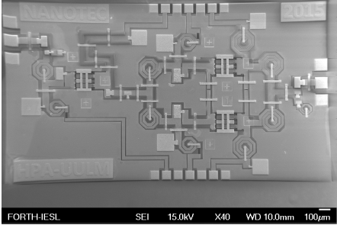
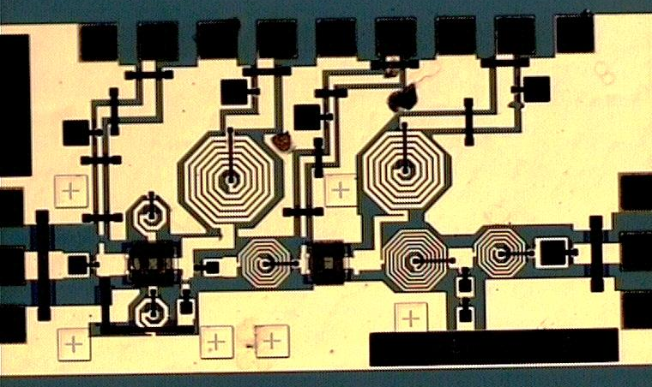
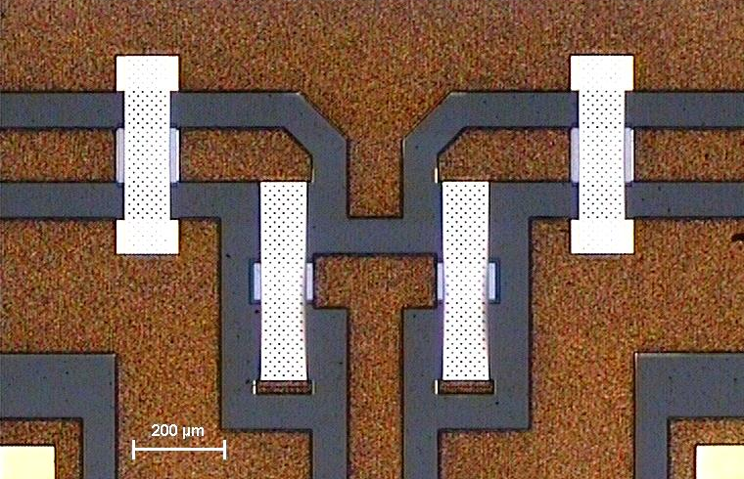
SMARTEC Concept & Objectives
Coplanar technology on GaN based substrate
  No back side technology (Vias/thinning) ➔ fewer technological steps
  Productivity : Fabrication time reduced by a week, much higher yield and more components per fabrication Scalability: no limitation of substrate size
  Price: decreased cost per TRX module by 25%
  “Smart ability” by creating more complex/miniaturised RF devices due to its capability to allow 3D integration and easy incorporation of other elements like sensors.
CPW HPA
CPW SPDT MEMS-RF
CPW LNA

Slide 12
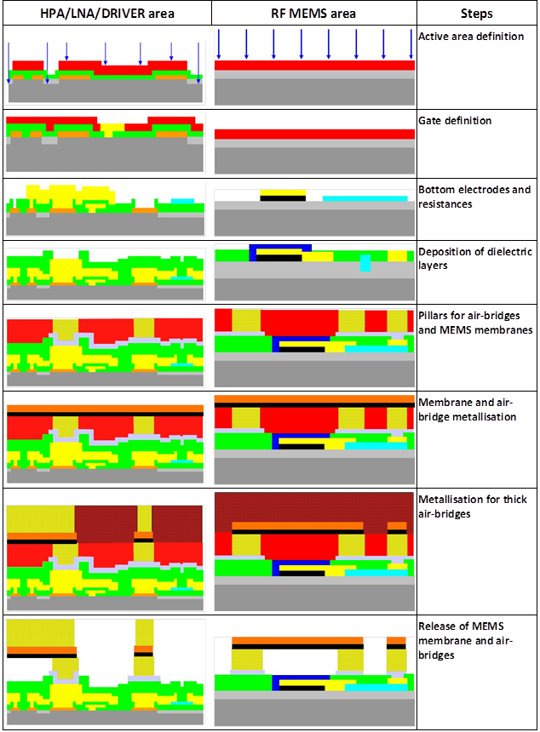
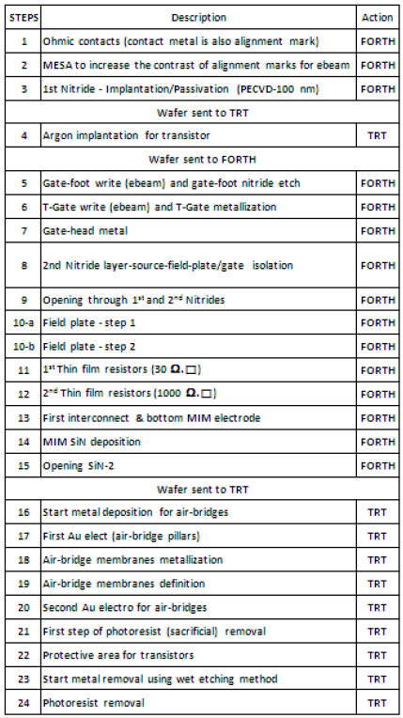
SMARTEC Concept & Objectives
Description of technology
  Technology developed jointly between TRT & FORTH
Monolithic integration on GaN based substrate
Coplanar technology
Standard microelectronic process
Compatible with large surface
About 20 technological steps
E-beam & contact lithography
Different dielectrics (SiN, Y₂O₃) by PVD and CVD
Different thin film metallization (Ti, Au, Pt, TiW …) by different technics such as evaporation, sputtering …
Technological transfer TRT
➔ FORTH for Pilot line

Slide 13




SMARTEC Concept & Objectives
TEC Integration for high power density ➔ Thermal management
  Thermal architecture costs
  Reliability issues
  Limitation of power use/ density
Innovative Nano and Micro Technologies for Advanced Thermo and Mechanical Interfaces
Smart integration of GaN & SiC high power electronics for industrial and RF applications
Nanostructured ThermoElectric Systems for Green Transport & Energy Efficient Applications
QUANTItative scanning probe microscopy techniques for HEAT transfer management in nanomaterials and nanodevices
Ultra-versat!ile Nanoparticle Integration into Organized Nanoclusters

Slide 14
SMARTEC Concept & Objectives
Active Cooling : General principle
  Provide thermoelectric heat dissipation
    Design cooling architecture integrating a TE cooler
Chip
Heatspreader (optionnal)
PCB platform
Cold plate
Possible passive cooling architecture (present)

Slide 15
SMARTEC Concept & Objectives
Active cooling architecture
Large Peltier (~1-2cm, thickness<1mm)
Small Peltier (~3-9mm, thickness<<1mm)
Exact dimensions strongly depend on other elements dimensions (chip size & thickness, platform design, acceptable additionnal thickness for the Peltier)
But also on
Thermal requirements (chip power density, cold plate-to-ambiant thermal resistance,)
Peltier cooler performance (Peltier material, Peltier fabrication process capabilities i.e. TE leg minimal dimensions)
And on system electrical power supply availability (number of TE legs give voltage/current requirements for the Peltier)

Slide 16
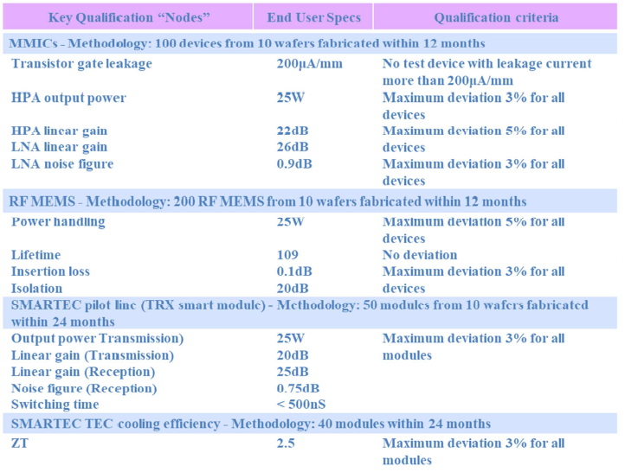
SMARTEC Concept & Objectives
SMARTEC Pilot Line Technological Objectives to be qualified

Slide 17
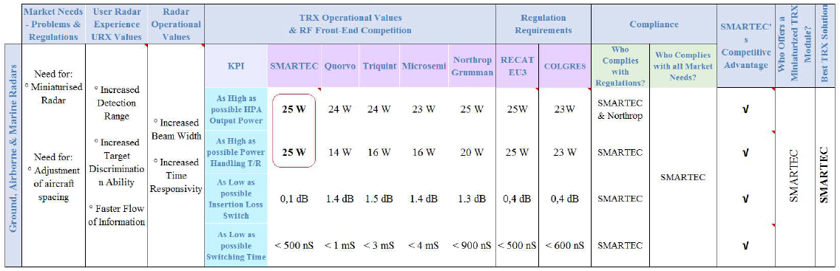
SMARTEC Concept & Objectives
SMARTEC’s competitive advantage vs market needs & regulation

Slide 18
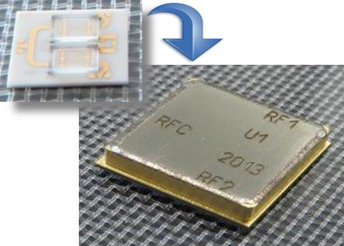
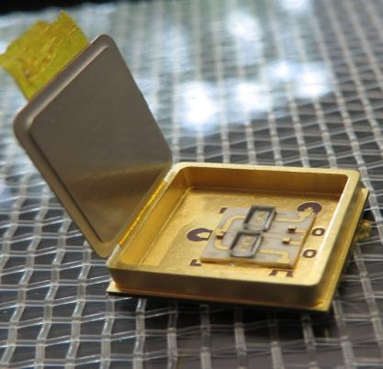
SMARTEC Concept & Objectives
Demonstrator integration for tests
  JIG test for validation of performances
CPW TRX Module
PCB Cu drain
Testing jig
Peltier
Cold Plate
BGA

Slide 19
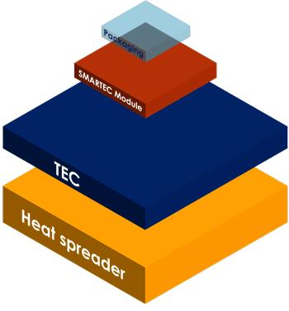
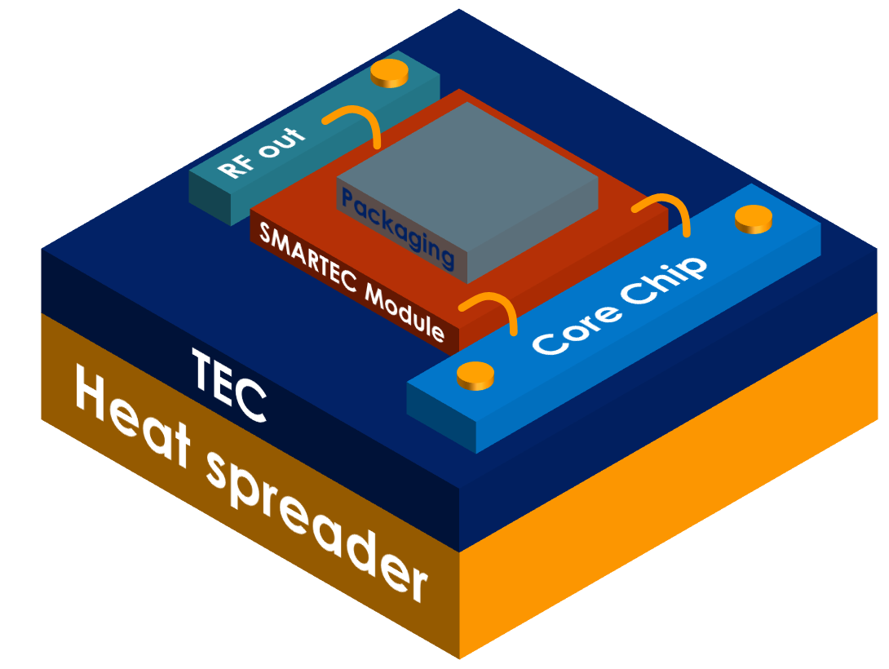
SMARTEC Concept & Objectives
Demonstrator integration ➔ New configuration of Radar system integration
  Maturity Growth of the CPW T/R module technology with WLP (TRL6 ➔ TRL8)
  Setup of Pilot line at FORTH as “SMARTEC modules” provider
  TEC integration (if needed) provided by CIDETE for thermal management
  Packaging for system Integration using TAIPRO means
2 DEMONSTRATORS addressed for THALES & RFM
RF IN

Slide 20
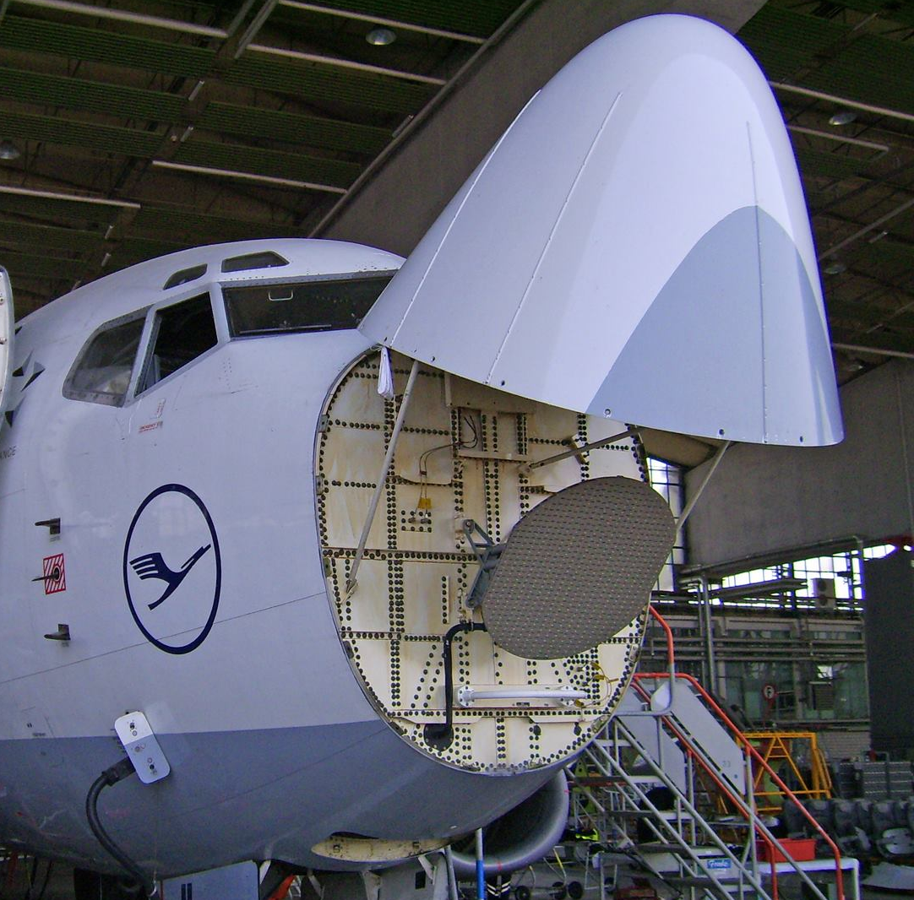
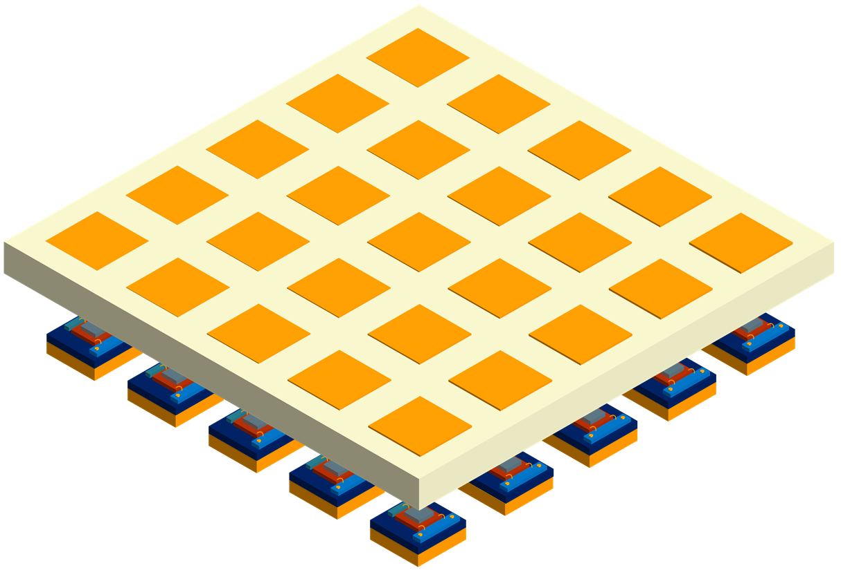
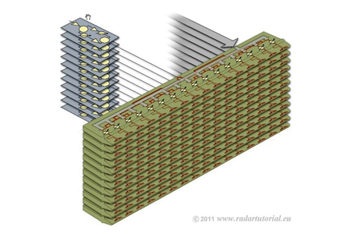
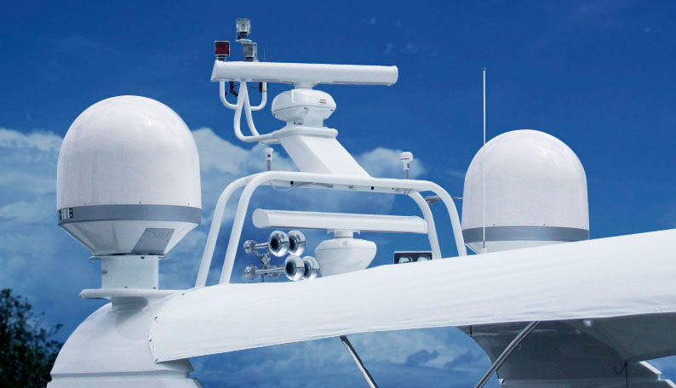
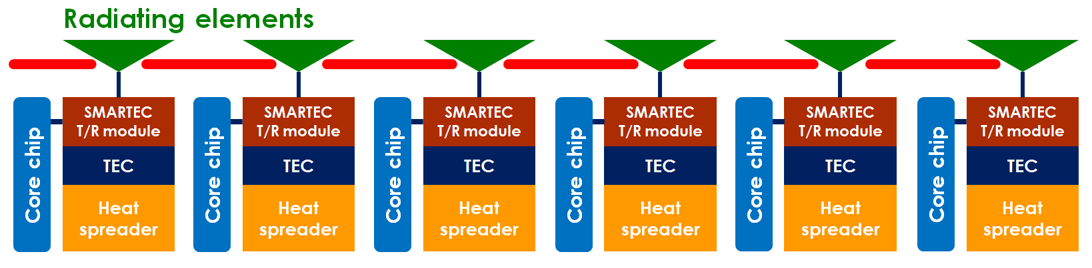
SMARTEC Concept & Objectives
Demonstrators for Avionics & Marine Radars
  SMARTEC project towards a new radar system configuration
    Higher integration/compact
    higher performances
    Lower costs
Radar front end
Towards
Current AESA radar configuration

Slide 21
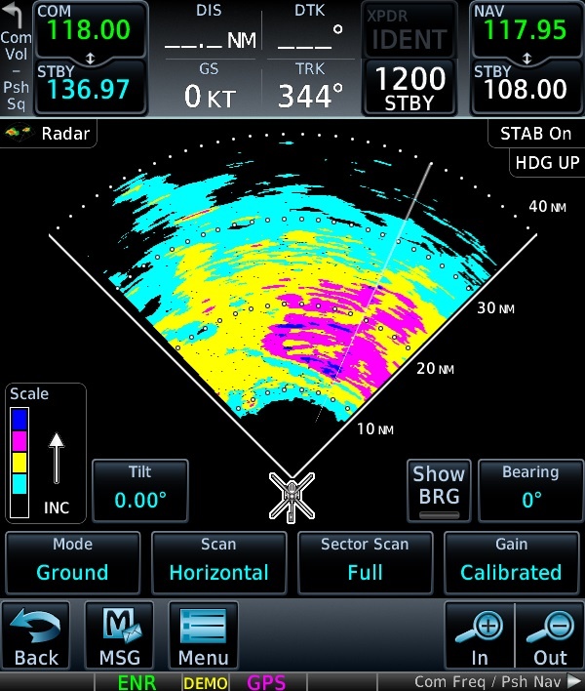
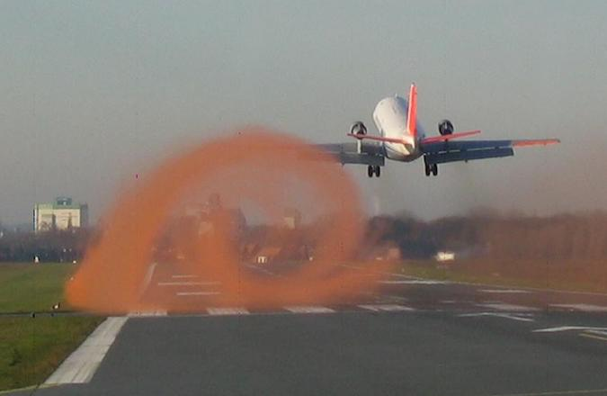
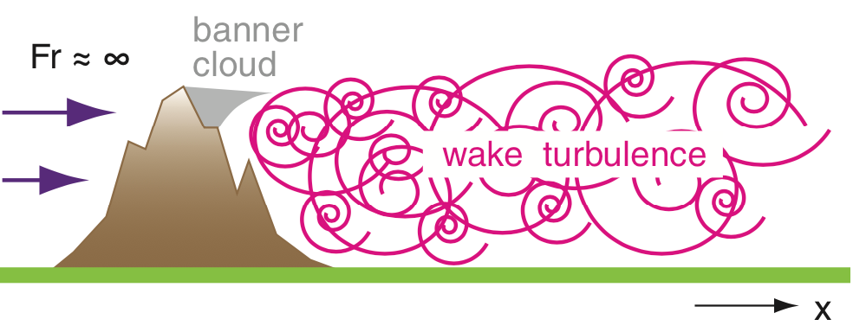
SMARTEC Concept & Objectives
THALES Demonstrator for Avionics Radars (DEMO 1)
  reconfigurable smart module for higher performance radar (vortex detection, weather …)
    X-band/Higher power handling (> 25W)
    Better thermal management by integrating TEC technology
    Reduction of sizes ➔ compact modules & low cost
    RF Performances, robustness, reliability …

Slide 22
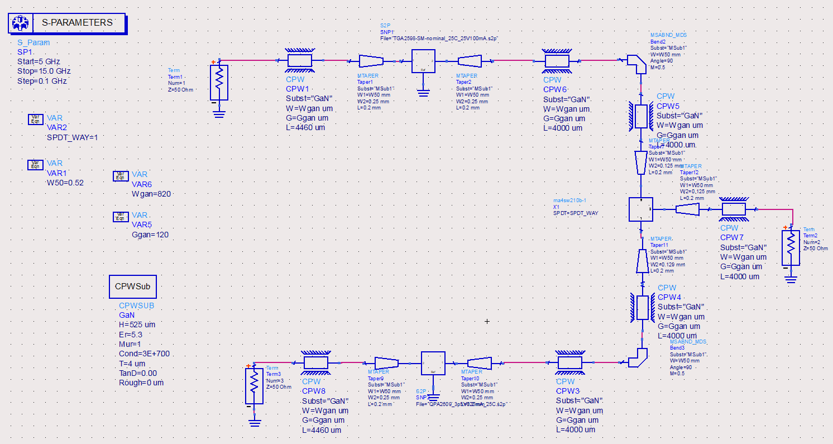
SMARTEC Concept & Objectives
THALES Demonstrator for Avionics Radars (DEMO 1)
  Definition of circuit model of T/R module for THALES
HPA
Core Chip
Radiating element
SPDT MEMS
LNA
SMARTEC T/R Module for THALES DEMO

Slide 23
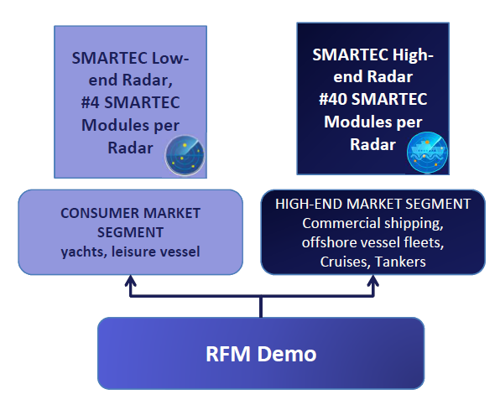
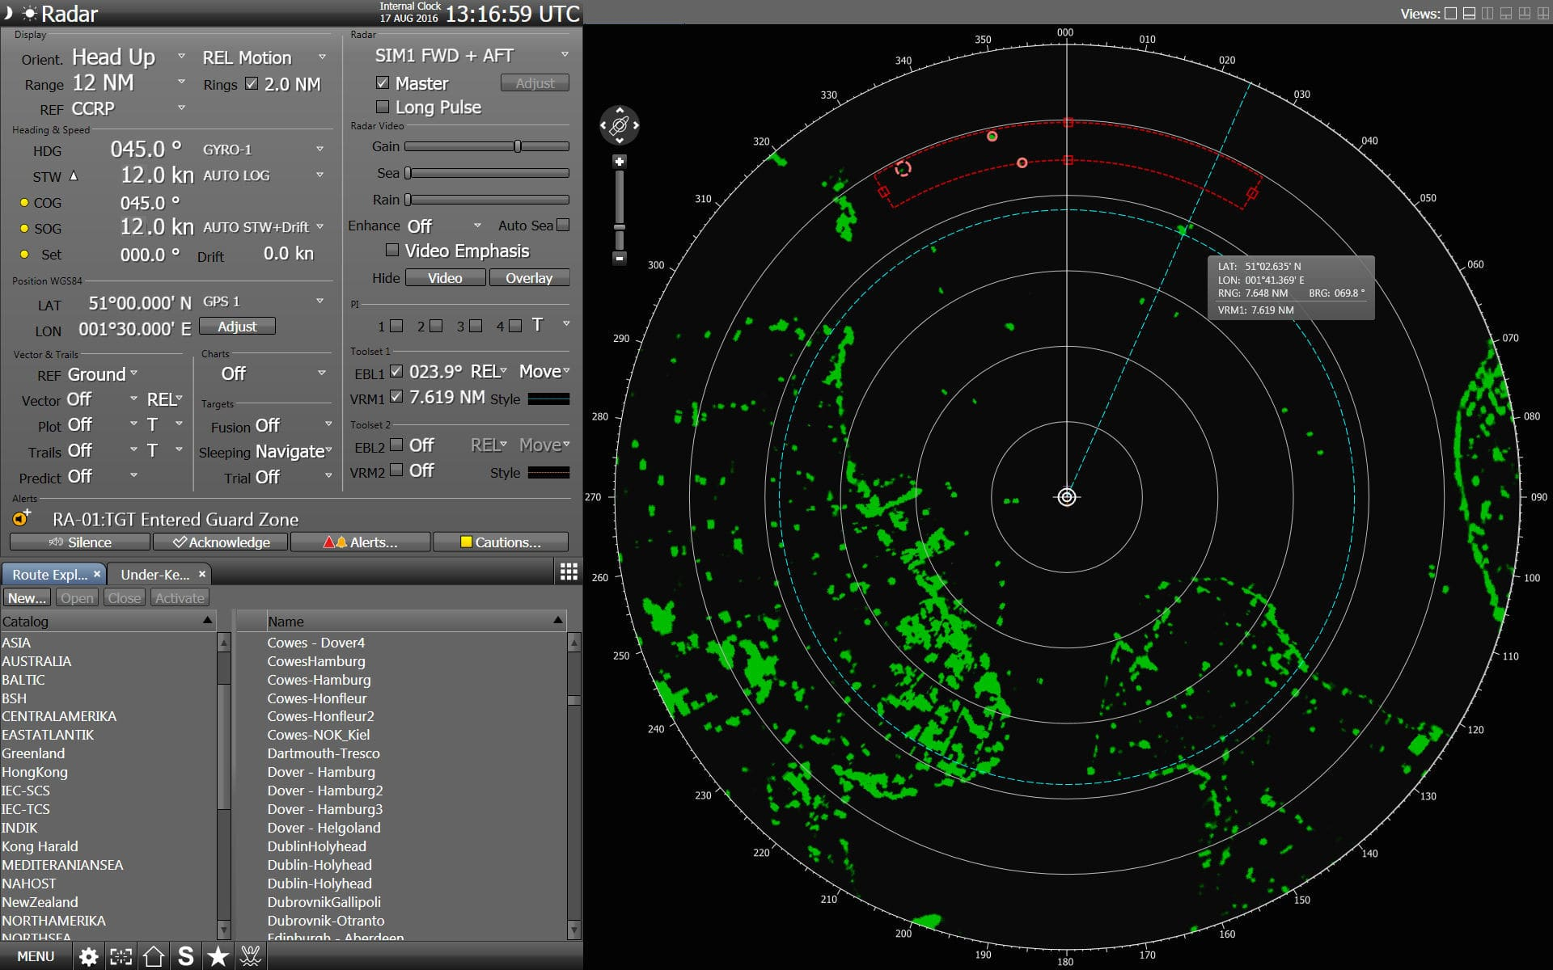
SMARTEC Concept & Objectives
RFM Demonstrator for Marine Radar (DEMO 2)
Key SMARTEC module advantages
• The high miniaturization of SMARTEC module will allow to accommodate a large number of modules (up to 1 module for each radiating element)
• Reduction of Costs
• Higher Power Handling

Slide 24
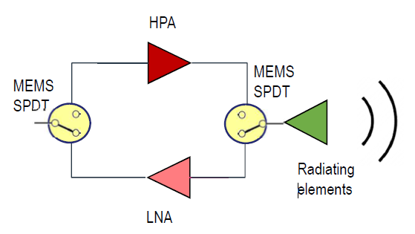
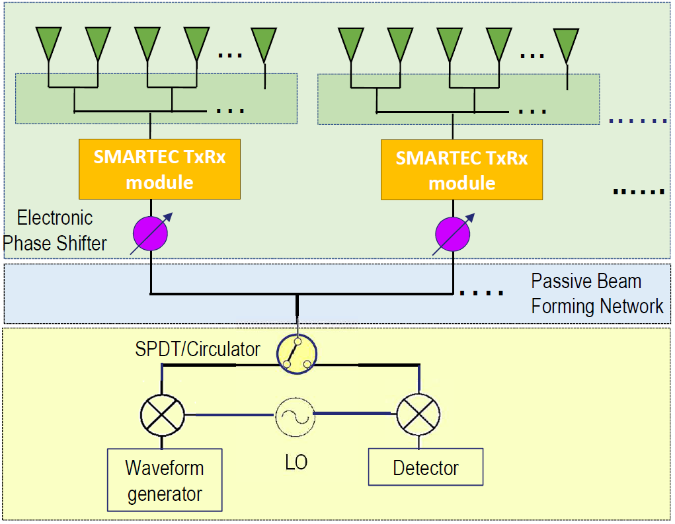
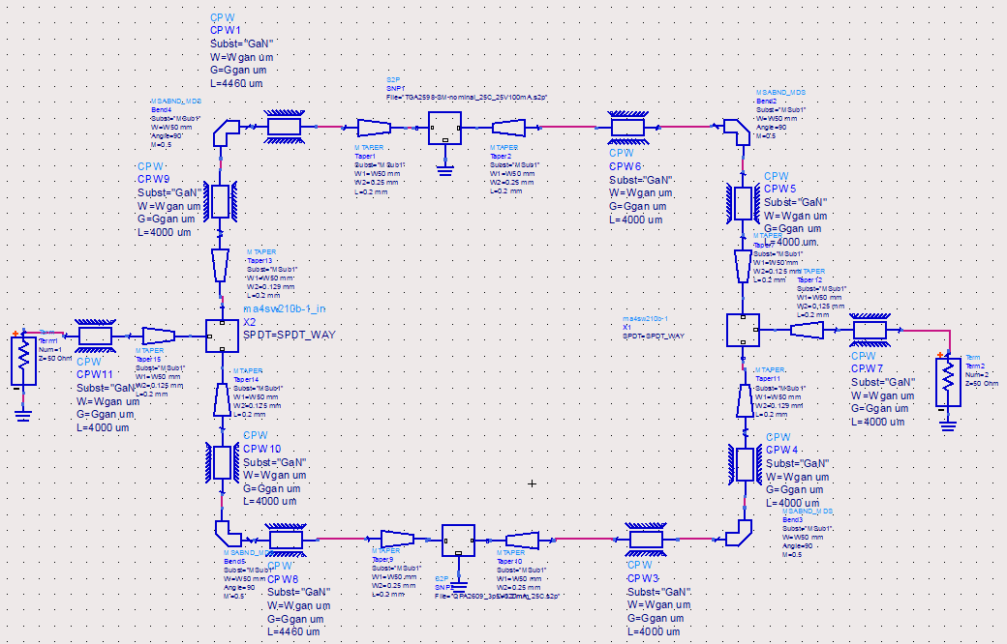
SMARTEC Concept & Objectives
Definition of circuit model for RFM DEMO 2
SMARTEC Module
RFM DEMO 2

Slide 25
SMARTEC Concept & Objectives
SMARTEC Technical Objectives
TO1 | Build the SMARTEC pilot line Establish a qualified pilot line at FORTH for the production of the SMARTEC reconfigurable RF modules
TO2 | Qualify the technical objectives of the unique coplanar technology and raise its TRL from 6 to 8 Complete the innovation cycle by raising the SMARTEC RF smart module technology from TRL 6 to TRL 8 by validating the RF front-end in real working conditions.
TO3 | Produce product prototypes for avionics and marine applications Demonstrate the pilot line’s capability to deliver a market ready front-end prototype

Slide 26
SMARTEC Concept & Objectives
SMARTEC Business Objectives
BO1 | Create an entity which will fill a gap in the European power RF front-end industry, exploiting the SMARTEC unique coplanar monolithic technology that will : BO1.1 : Change the game in power RF Front-End industry at a European and at international level BO1.2 : Address niche radar markets of high power RF performance and high added value and of medium unit volume, with reconfigurable power GaN RF solutions BO1.3 : Address luxury marine markets with reconfigurable power GaN RF solutions BO1.4 : (a) Define the market segmentation attributes (b) the market penetration and IP strategy (c) work on structuring basic distribution channels BO1.5 : Potentially address upcoming medium or high power reconfigurable RF needs of mass markets (cost driven, e.g telecom) with lower cost solutions BO1.6 : Contribute to the competitiveness of the EU economy, through a strategic alliance of EU partners, as well as creation of new jobs. BO1.7 : Contribute to the creation of new jobs in the EU

Slide 27
Outline
Consortium & Project Overview
SMARTEC Concept & Objectives
Project Organization & Management Structure
Highlights and overall achievements of each work package

Slide 28
Project Organization
Work Packages of SMARTEC project
  5 Work Packages
WP n° | Title | Starting date | Ending date | Total efforts | Lead beneficiary
WP1 | Project Management | T₀ | T₀+36 | 23 PMs | TRT
WP2 | SMARTEC Pilot Line | T₀ | T₀+24 | 160 PMs | FORTH
WP3 | Prototyping | T₀+18 | T₀+36 | 83 PMs | RFM
WP4 | Marketing & Business Development | T₀+6 | T₀+36 | 124 PMs | CIDETE
WP5 | Ethics Requirements | T₀ | T₀+36 | - | TRT

Slide 29
Project Organization
Repartition in time of Work Packages
WPs | T₀+6 | T₀+12 | T₀+18 | T₀+24 | T₀+30 | T₀+36
WP1 Project Management
WP2 Pilot Line
WP3 Prototyping
WP4 Marketing & Business Development
WP5 Ethics Requirements

Slide 30
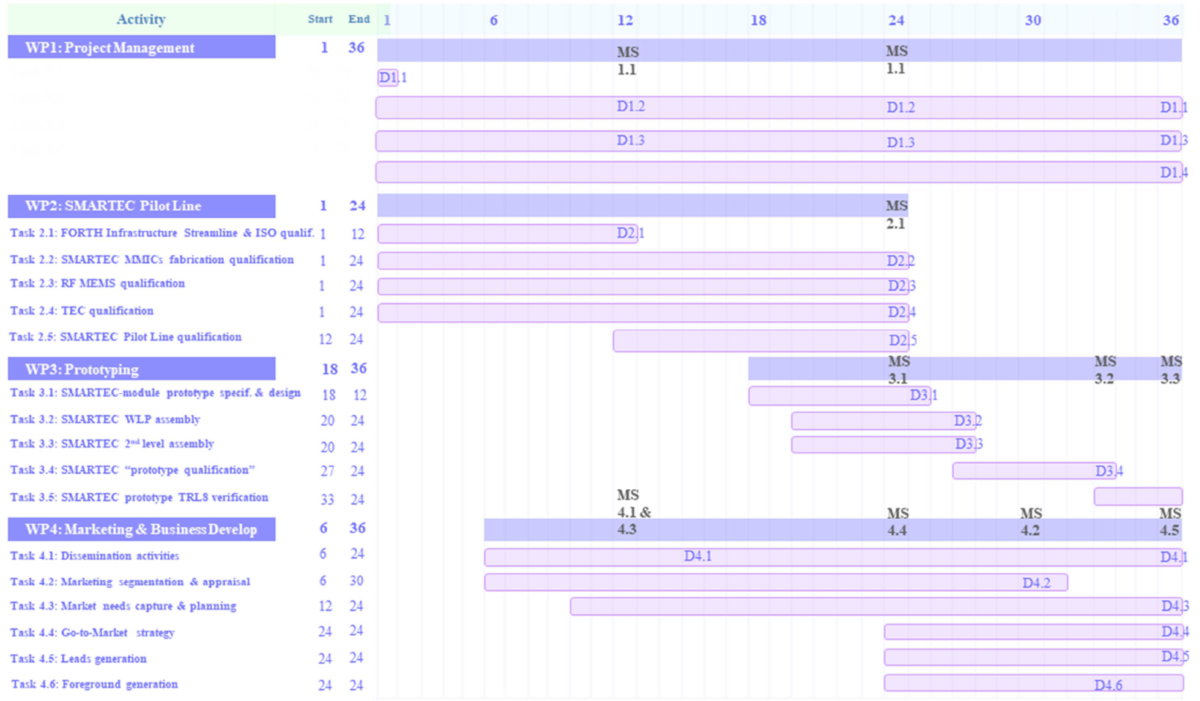
Project Organization
Detailed Gantt Chart as function of tasks

Slide 31
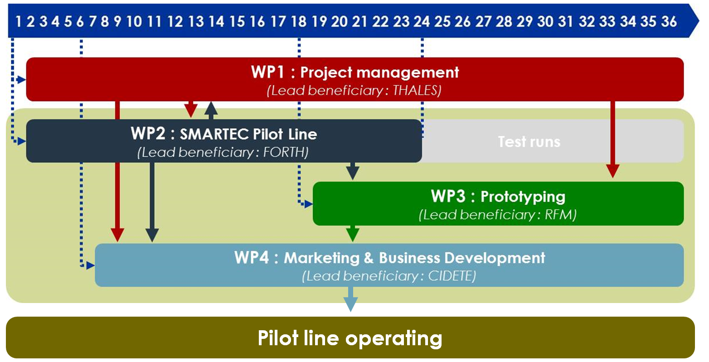
Project Organization
Interaction between Work Packages

Slide 32
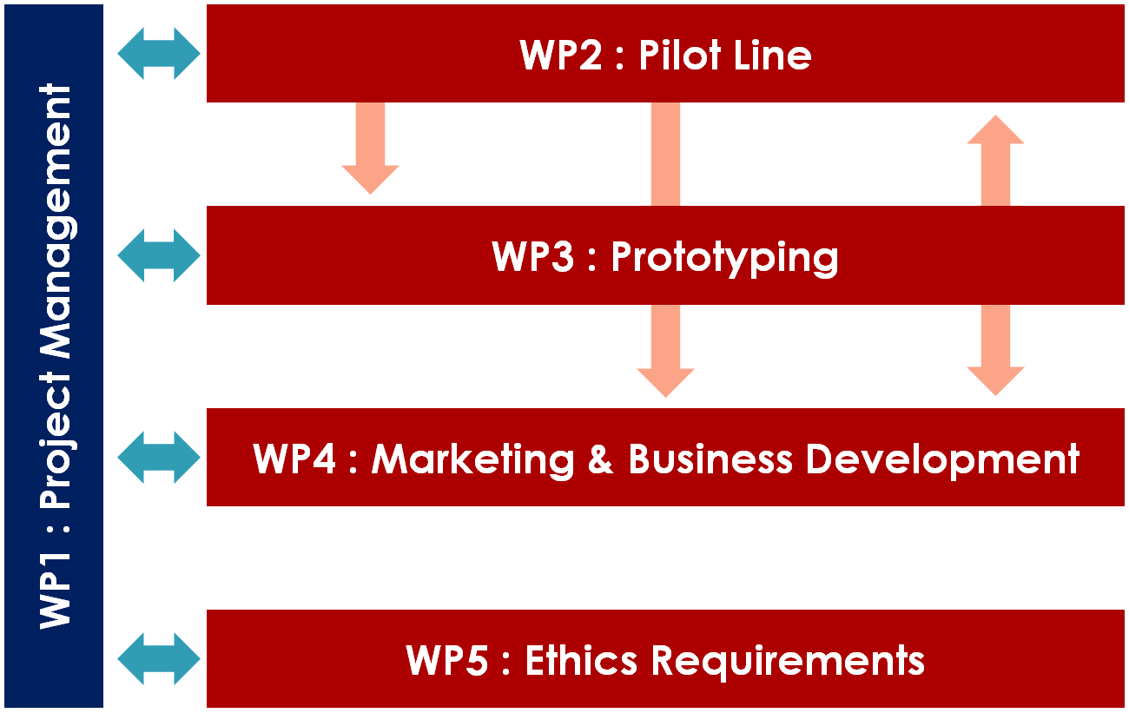
Project Organization
Work Packages flow

Slide 33
Project Organization
Repartition of efforts per Work Package & partner
 | WP1 | WP2 | WP3 | WP4 | WP5 | Total PMs per participant
1-THALES | 12 | 20 | 29 | 25 | ✓ | 86
2-CIDETE | 4 | 37 | 18 | 40 |  | 99
3-RFM | 2 | 9 | 12 | 14 |  | 37
4-FORTH | 4 | 82 | 4 | 40 |  | 130
5-TAIPRO | 1 | 12 | 20 | 5 |  | 38
Total PMs | 23 | 160 | 83 | 124 |  | 390

Slide 34
Project Organization
Deliverables expected over all project (T₀ ➔ T₀+36)
  27 deliverables
N° | Title | Type | Due date | Dissemination Level | Lead beneficiary
D1.1 | Consortium agreement | Other | T₀+1 | Confidential | THALES
D5.2 | GEN – Requirement No. 3 | Ethics | T₀+1 | Confidential | THALES
D5.1 | POPD – Requirement No. 2 | Ethics | T₀+6 | Confidential | THALES
D1.2 | Progress activity report of Y1 | Report | T₀+12 | Confidential | THALES
D1.3 | Progress management reports & Y1 Cost statements | Report | T₀+12 | Confidential | THALES
D2.1 | Report on FORTH infrastructure and ISO 9001 certificate | Report | T₀+12 | Public | FORTH
D4.1 | Report on dissemination activities (1st version) | Report | T₀+15 | Public | FORTH
D1.4 | Progress activity report of Y2 | Report | T₀+24 | Confidential | THALES

Slide 35
Project Organization
Deliverables expected over all project (T₀ ➔ T₀+36)
  27 deliverables
N° | Title | Type | Due date | Dissemination Level | Lead beneficiary
D1.5 | Progress management reports & Y2 Cost statements | Report | T₀+24 | Public | THALES
D2.2 | Report on qualified MMICs | Report | T₀+24 | Public | FORTH
D2.3 | Report on qualified RF-MEMS | Report | T₀+24 | Confidential | FORTH
D2.4 | Report on qualified TEC | Report | T₀+24 | Public | CIDETE
D2.5 | Report on qualified pilot line | Report | T₀+24 | Public | FORTH
D3.1 | Report on SMARTEC prototype specifications and design | Report | T₀+25 | Confidential | THALES
D3.2 | Report on WLP qualification | Report | T₀+27 | Public | TAIPRO
D3.3 | Report on 2nd level packaging qualification | Report | T₀+27 | Public | TAIPRO

Slide 36
Project Organization
Deliverables expected over all project (T₀ ➔ T₀+36)
  27 deliverables
N° | Title | Type | Due date | Dissemination Level | Lead beneficiary
D4.2 | Market segmentation and appraisal - preliminary version | Report | T₀+30 | Confidential | CIDETE
D4.3 | SMARTEC patent application | Website, patents filling, etc. | T₀+33 | Confidential | THALES
D3.4 | Report on qualified SMARTEC prototype qualification | Report | T₀+33 | Confidential | THALES
D1.6 | Progress activity report of Y3 | Report | T₀+36 | Confidential | THALES
D1.7 | Progress management reports & Y3 Cost statements | Report | T₀+36 | Confidential | THALES
D1.8 | Final Global consolidated report | Report | T₀+36 | Confidential | THALES
D3.5 | Report on prototype conformity to TRL8 | Report | T₀+36 | Public | RFM

Slide 37
Project Organization
Deliverables expected over all project (T₀ ➔ T₀+36)
  27 deliverables
N° | Title | Type | Due date | Dissemination Level | Lead beneficiary
D4.4 | Report on dissemination activities (Final version) | Report | T₀+36 | Public | FORTH
D4.5 | Market segmentation and appraisal (including needs & planning) – final version | Report | T₀+36 | Confidential | THALES
D4.6 | Go to market strategy | Report | T₀+36 | Confidential | THALES
D4.7 | SMARTEC media roadmap | Report | T₀+36 | Confidential | RFM

Slide 38
Project Organization
Milestones expected over all project (T₀ ➔ T₀+36)
  12 Milestones
N° | Title | WP | Due date | Lead beneficiary
MS1 | Review meetings-Y1 | WP1 | T₀+12 | THALES
MS2 | Pilot line and Ind. Partners 1st revised business plans | WP4 | T₀+12 | FORTH
MS3 | Pilot Preliminary marketing strategy assessment | WP4 | T₀+12 | FORTH
MS4 | Review meetings-Y2 | WP1 | T₀+24 | THALES
MS5 | Qualified MMIC, RF MEMS and TEC | WP2 | T₀+24 | THALES
MS6 | Qualified prototype chipset | WP3 | T₀+24 | RFM
MS7 | Pilot Intermediate marketing strategy assessment | WP4 | T₀+24 | CIDETE
MS8 | Pilot line and Ind. Partners 2nd revised business plans | WP4 | T₀+30 | FORTH
MS9 | Qualified prototype module | WP2 | T₀+33 | THALES
MS10 | Review meetings-Y3 | WP1 | T₀+36 | THALES
MS11 | SMARTEC Pilot line | WP3 | T₀+36 | FORTh
MS12 | Final Pilot Marketing strategy assessment | WP4 | T₀+36 | THALES

Slide 39
Project Organization
Critical Implementation risks and mitigation actions (1/4)
Risk n° | WP n° | Description of risk | Risk Level | Proposed risk-mitigation measures
1 | WP1 | Possible small delay in the setup of the various teams | Likelihood: Medium Severity : Low | Using preliminary specs to initiate tasks (TRT)
2 | WP2 | Prototype chipset not meeting qualification criteria | Likelihood : Low Severity : Medium | Identify & solve problem; new iteration (FORTH). Only cause minor delay
3 | WP3 | Prototype module not meeting qualification criteria | Likelihood : Low Severity : High | Use standard RF ceramic package (TAIPRO). Again this is a less elegant but secure alternative solution thus in practice there will be no effect on performance.
4 | WP3 | SMARTEC prototype module fails at TRL8 | Likelihood : Low Severity : High | Two iterations have been envisaged (TRT, RFM)
5 | WP4 | Initial cash flow shortages for the pilot line | Likelihood : Low Severity : High | The pilot line has secure initial income from the early adopters (Thales, RFM). FORTH will support the Pilot line for the first 5 years by absorbing the overhead costs thus minimizing financial risks. As been described in the business canvas, focused activities to secure additional funding will be undertaken during the project thus lower cash flow risks

Slide 40
Project Organization
Critical Implementation risks and mitigation actions (2/4)
Risk n° | WP n° | Description of risk | Risk Level | Proposed risk-mitigation measures
6 | WP4 | Competition Strength (Avionic radar) | Likelihood : Medium Severity : High | Our future offer will range from global ATC system down to radar equipment that can be seamlessly interfaced with current systems, reducing integration costs. Raytheon is our main competitor, and will invest in similar solutions, but based on a different technology (diodes), that will lead to poorer performances. However, it is also critical to be the first on the market (TRT).
7 | WP4 | Competition Strength (Marine radar) | Likelihood : Medium Severity : High | The new offer will range from global Radar and telecommunication system down to T/R modules equipment that can be seamlessly interfaced with current systems, reducing integration costs. Raymarine Inc and Kelvin Hughes are our main competitors, and will invest in similar solutions, but based on a different technology (diodes), that will lead to poorer performances. However, it is also critical to be the first on the market (RFM).
8 | WP4 | Time to market | Likelihood : Medium Severity : High | Periodic technological survey on competitors solutions. Time-to-market speed-up if needed, using additional investment and resources (ALL).

Slide 41
Project Organization
Critical Implementation risks and mitigation actions (3/4)
Risk n° | WP n° | Description of risk | Risk Level | Proposed risk-mitigation measures
9 | WP4 | Market volume reliability | Likelihood : Medium Severity : High | Adjustment of the investment and resources as function of the volume variation. Radar market volume is quite reliable because of customer renovation cycle (typ. 15 years), and customer need to comply to regulation changes (2022 RECAT-EU3) (TRT)
10 | WP4 | Price | Likelihood : Medium Severity : High | By design, radar recurrent costs (production, installation and exploitation) will be lower than current solutions (because mechanical parts are replaced by electronic sweeping). Customer value will be higher than the cost of the solution, because financial income due to using our solution (airports, airlines) will be higher than the price of our solution.(TRT)
11 | WP4 | Demand for the pilot line too much | Likelihood : Medium Severity : High | This could happen after the end of the project. A decision will be taken either to invest in increasing the throughput capacity or to sell the SMARTEC IP to an established European foundry (ALL)

Slide 42
Project Organization
Critical Implementation risks and mitigation actions (4/4)
Risk n° | WP n° | Description of risk | Risk Level | Proposed risk-mitigation measures
12 | WP4 | Equipment failure | - | This risk refers to the post SMARTEC period. However, as has been stated in 1.3.3.1, we already foresee two months downtime for equipment repair/service which according to our experience is enough in most cases. To cover exceptional cases, an appropriate clause will be included in the insurance policy of future contracts (FORTH)
13 | WP4 | After sales malfunction | - | This risk refers to the post SMARTEC period. However, the pilot line will study the necessary means to mitigate it in the form of insurance policy to be included in future contracts (FORTH)
14 | WP4 | Compliance to EEA (European Environment Agency) or EPA (Environmental Protection Agency) standards. | Likelihood : Low Severity : Low | Pilot line production may be slightly delayed. Adaptation of the products to the new regulations. Compliance of products specified by customers would be guaranteed by customers themselves.

Slide 43
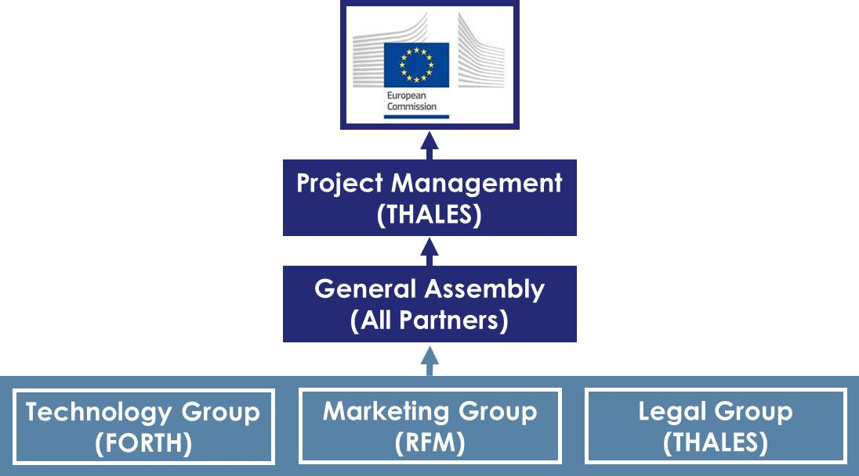
Management Structure

Slide 44
Management Structure
Project coordinator
  Represent the participants in the framework of the EC contract
  Afshin ZIAEI, TRT
  Responsible for the overall management of the project:
    Following-up of the EC decisions
    Reviewing and submitting reports and deliverables to EC
    Administrating the General Assembly and the Executive Board
    Allocating financial EC contributions in accordance with the Grant Agreement and the General Assembly
    Monitoring compliance by the parties with their obligations under the Grant Agreement
    Ensuring the quality of the management of the project

Slide 45
Management Structure
General Assembly
  Highest decision-making entity of the project
  1 representative / participant, chaired by coordinator
  Responsible for the overall direction of the project :
    Approving Grant/Consortium Agreements
    Approving project plan, project budget and rules for the management of funds
    Approving major changes in work, in concertation with EC
    Approving procedures and policies for the use and dissemination of Foreground
    Approving press releases and publications
  At least 4 General Meetings / year

Slide 46
Management Structure
General Assembly Representatives
Participants | General Assembly Representatives
1-THALES | Afshin ZIAEI | afshin.ziaei@thalesgroup.com
2-CIDETE | German NORIEGA | gnoriega@cidete.com
3-RFM | Hamza EL GHANNUDI | ghannudi@rfmicrotech.com
4-FORTH | George KONSTANTINIDIS | aek@physics.uoc.gr
5-TAIPRO | Bruno HEUSDENS | b.heusdens@taipro.be

Slide 47
Role & Responsibilities
Executive Board
  Coordinating and supervisory body for the project execution
  Compound of the WP leaders, chaired by the coordinator
  Responsible for the coordination of the technical activities:
    Making proposals to the GA for allocation of the project plan, project budget and rules for the management of funds
    Making proposal to the GA for review/amendment in the terms of the Grant agreement
    Selecting and proposing new parties or additional expertise
    Deciding on technical roadmaps for the project
    Supporting the coordinator in preparing deliverables, meetings and related data
  At least 2 Executive Meetings / year

Slide 48
Role & Responsibilities
Executive Board (WP leaders)
Work Package |  | WP leaders
1 | Project Management | THALES | Afshin ZIAEI | afshin.ziaei@thalesgroup.com
2 | SMARTEC Pilot Line | FORTH | George KONSTANTINIDIS | aek@physics.uoc.gr
3 | Prototyping | RFM | Paola FARINELLI | farinelli@rfmicrotech.com
4 | Marketing & Business Development | CIDETE | German NORIEGA | gnoriega@cidete.com
5 | Ethics Requirements | THALES | Afshin ZIAEI | afshin.ziaei@thalesgroup.com

Slide 49
Role & Responsibilities
WP Leaders
  Coordinating the work carried in each WP
  Responsible of the tasks within the WP
  Responsible for the coordination of the technical activities:
    Planning, monitoring and reporting of the tasks within the WP
    Administrating the WP management team
    Transmission of documents, information and deliverables to the WP participants and to the coordinator
    Coordinating on a day-to-day basis the progress of the technical work
    Reviewing deliverables and advise the coordinator if delays

Slide 50
Role & Responsibilities
WP management teams
  In charge of the management of each WP
  1 representative of each contractor having a task in the given WP, chaired by the WP leader
  Responsible for the execution and the progress of the technical activities relevant to each WP:
    Deciding upon allocation of the WP budget
    Alerting Executive Board and Coordinator in case of delay in the performance
    Preparing proposal and action plan to the Executive Board
    Assisting the WP leader in the day-to-day coordination of the WP tasks

Slide 51
Outline
Consortium & Project Overview
SMARTEC Concept & Objectives
Project Organization & Management Structure
Highlights and overall achievements of each work package

Slide 52
Highlights SMARTEC : Year 1
WP1 : Project Management

Slide 53
WP1 : Project mangement
Photo KoM ????
Several meetings organized
Kick of Meeting
3 general meetings with all partners
6 technical meetings
Almost all of meeting have done by phone call due the sanitary context

Slide 54
Highlights SMARTEC : Year 1
WP2 : SMARTEC Pilot Line

Slide 55
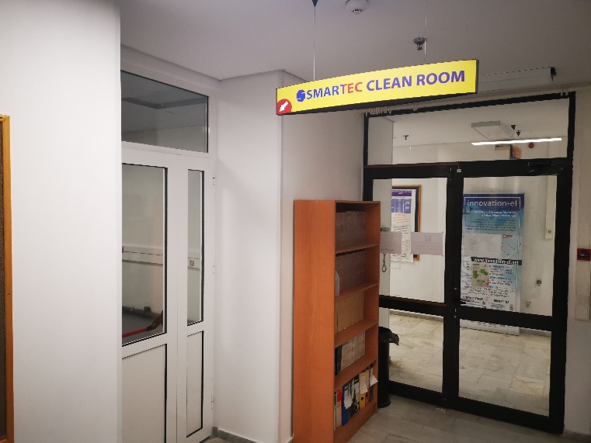
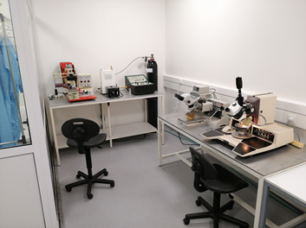
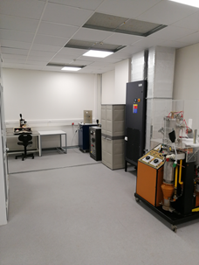
WP2-HL1: SMARTEC cleanroom & ISO 9001
Constructed
Operational
Mask aligner
Super Critical Dryer
Dye Bonder
Wire bonder
Thermal evaporator 1
Thermal evaporator 2
ISO quality system ready for trial period

Slide 56
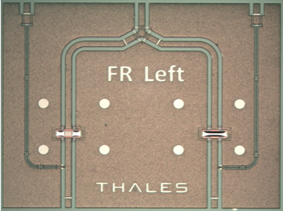
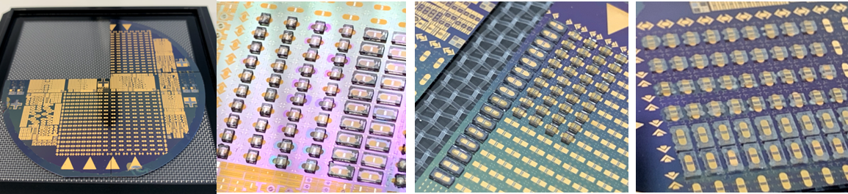
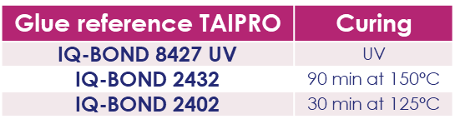
WP2-HL2: RF MEMS
New Hires at FORTH thanks to SMARTEC project
  Loukas MICHALAS as referrer on RF MEMS at FORTH
  Manos TRICHAS as Innovation Manager
New CPW SPDT switch design based on RF-MEMS for 25W & X-Band
  Design
  Fabrication
  Assessment
Technology transfer on going
Initial assessment of RF-MEMS packaging for qualification
 | Simulation (10 GHz) | Measurement (10 GHz)
Insertion Losses (S₃₁) | -0,7 dB | -0,72 dB
Return Losses (S₃₃) | -22 dB | -22,3 dB
Isolation (S₂₁) | -23,5 dB | -27,5 dB
Return Losses (S₂₂) | -0,3 dB | -0,36 dB

Slide 57
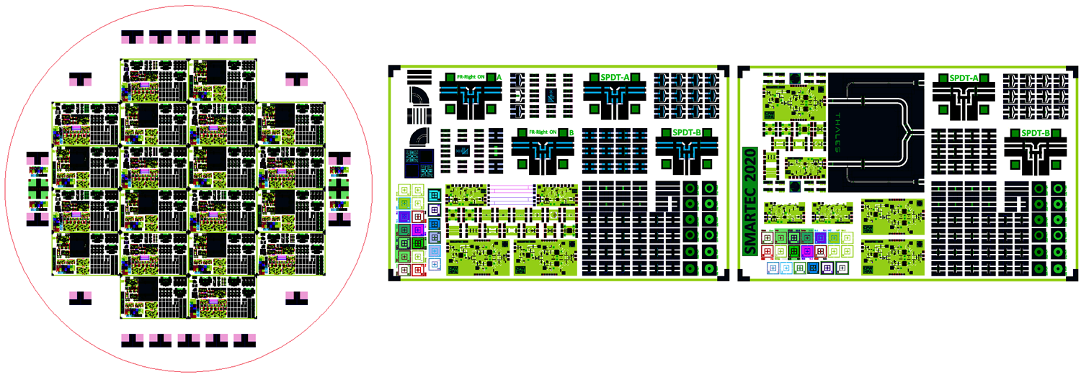
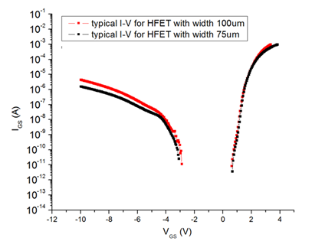
WP2-HL3: MMICs
SMARTEC MMICs Fabrication Qualification
  2 new layouts dedicated to 3-inch CPW fabrication
1st initial specs qualification (Transistor gate leakage current)
  Satisfies the SMARTEC objective (<200μA/mm)

Slide 58

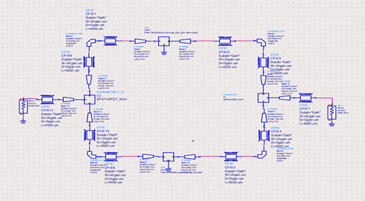
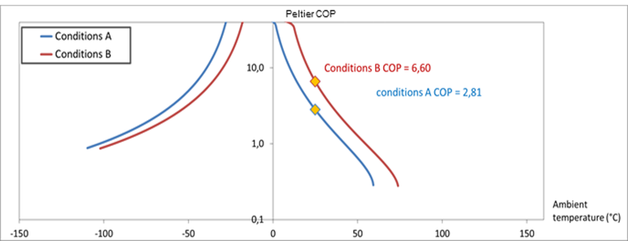

WP2-HL4: TRX module
Prototype circuit models
  Avionic Marine
Initial TEC qualification

Slide 59



Good use of EU funding
2013: 1st demonstration of integration of III-Nitride MMICs with RF MEMS
ENIAC project (TRL4)
2014: Functional microstrip III-nitride MMICs with RF MEMS
ENIAC project (TRL5)
2016: Functional coplanar monolithic III-nitride MMICs with RF MEMS
FP7 project (TRL6)
Sep 2019: Pilot line production of transceiver modules for the next generation of smart RF power applications
H2020 FTI project
2022: a new company

Slide 60
Highlights SMARTEC : Year 1
WP4 : Marketing & Business Development

Slide 61
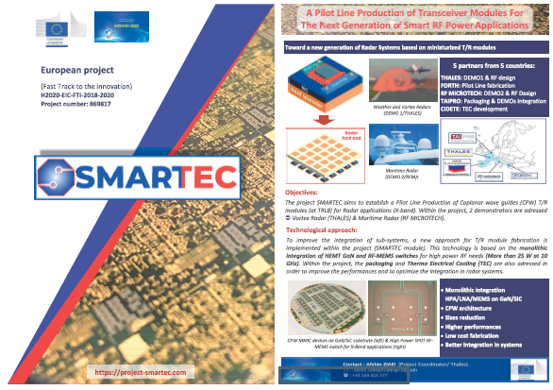
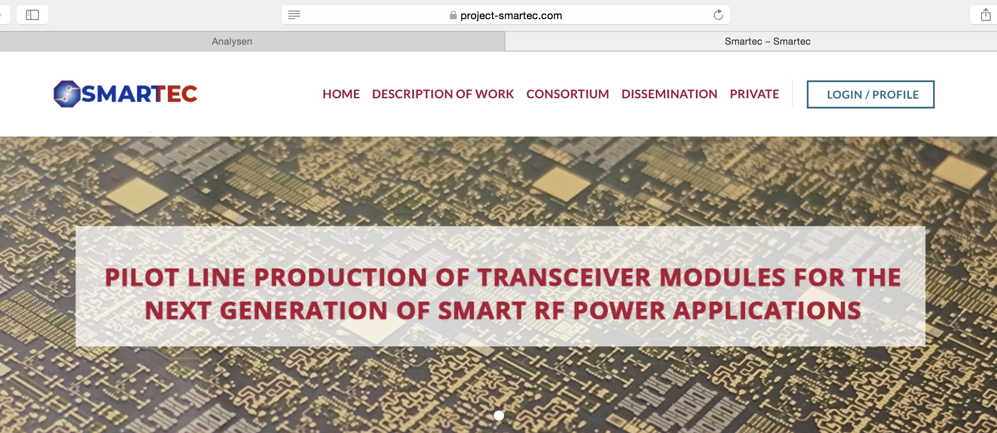

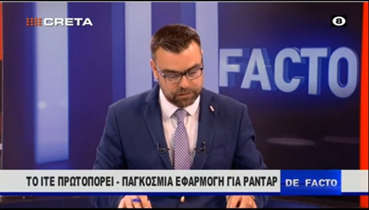
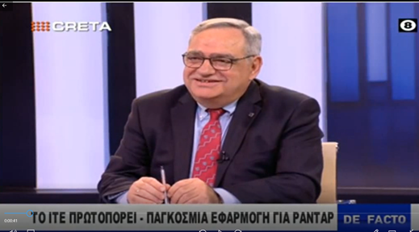
WP4 : DISSEMINATION
SMARTEC WEB PAGE (project-smartec.com)
SMARTEC Flyer for the consortium exhibitions
Paper submission to the international conference
“MEMS 2021”
(January 25-29)
Radar Conference with RFM
(September 20-25, 2020)
TV, Seminars

Slide 62
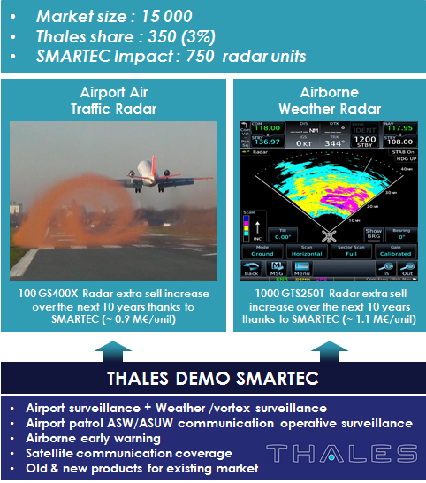
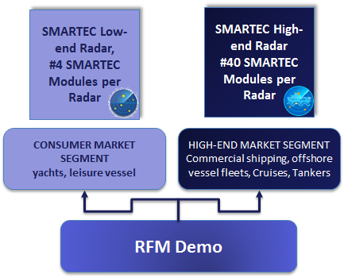
WP4 : Business model revision
SMARTEC DEMOs : THALES & RFM

Slide 63
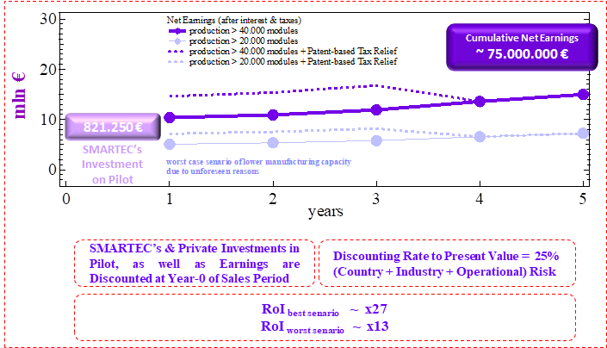
WP4 : Business model revision
X band expected to be business case Identified marine applications:
revised 5 years plan: estimated net earnings

Slide 64

Impact of sanitary crisis on SMARTEC project
Partners differently impacted
  TRT most impacted
    Closure of clean room & activities during 3 months
    Delays on RF-MEMS characterization, Packaging tests, hard masks delivery …
    All Partners indirectly impacted
  FORTH not closed during Covid-19 crisis but limitation of clean room activities (number of person working in clean room)
  TAIPRO not closed during Covid-19 crisis but limitation of clean room activities (number of person working in clean room)
  CIDETE & RFM activities less impacted but dependency from partners inputs
At least 9 months of delay on project without any other health measure limiting partners activities

