Slide 1
Review Meeting #1 WP1 : Project Management
Lead Beneficiary : THALES
Afshin ZIAEI
2020, November 3rd

Slide 2
WP1 : Project Management
Lead Beneficiary
THALES
Duration
From T₀ to T₀+36
Objectives
Coordinate the collaborative work between the project partners
Manage administrative, legal, and financial activities
Liaise with the European Commission
Monitor the gender issue

Slide 3
WP1 : Project Management
Efforts per partner
Partners | PMs
1 - THALES | 12
2 – CIDETE | 4
3 – RFM | 2
4 - FORTH | 4
5 - TAIPRO | 1
Total | 23

Slide 4
WP1 : Project Management
List of deliverables
3 deliverables expected in first period (Year 1)
Number | Deliverable Title | Due Date
D1.1 | Consortium agreement | T₀+1
D1.2 | Progress activity report of Y1 | T₀+12
D1.3 | Progress management reports & Y1 Cost statements | T₀+12
D1.4 | Progress activity report of Y2 | T₀+24
D1.5 | Progress management reports & Y2 Cost statements | T₀+24
D1.6 | Progress activity report of Y3 | T₀+36
D1.7 | Progress management reports & Y3 Cost statements | T₀+36
D1.8 | Final Global consolidated report | T₀+36

Slide 5
WP1 : Project Management
List of Milestones
3 milestones expected in first period (Year 1)
Number | Deliverable Title | Due Date
MS1 | Review meetings-Y1 | T₀+12
MS4 | Review meetings-Y2 | T₀+24
MS10 | Review meetings-Y3 | T₀+36

Slide 6
WP1 : Project Management
Gantt chart on WP1
WPs | T₀+6 | T₀+12 | T₀+18 | T₀+24 | T₀+30 | T₀+36
WP1 : Project Management
D1.1 : Consortium agreement (T₀+1)
D1.2 : Progress activity report of Y1
D1.3 : Progress management reports & …
D1.4 : Progress activity report of Y2
D1.5 : Progress management reports & …
D1.6 : Progress activity report of Y3
D1.7 : Progress management reports & …
D1.8 : Final Global consolidated report

Slide 7
WP1 : Project Management
Status of deliverables at M12
Number | Deliverable Title | Due Date | Status
D1.1 | Consortium agreement | T₀+1 | Deliver on time
D1.2 | Progress activity report of Y1 | T₀+12 | Deliver at T₀+14
D1.3 | Progress management reports & Y1 Cost statements | T₀+12 | Deliver at T₀+14

Slide 8
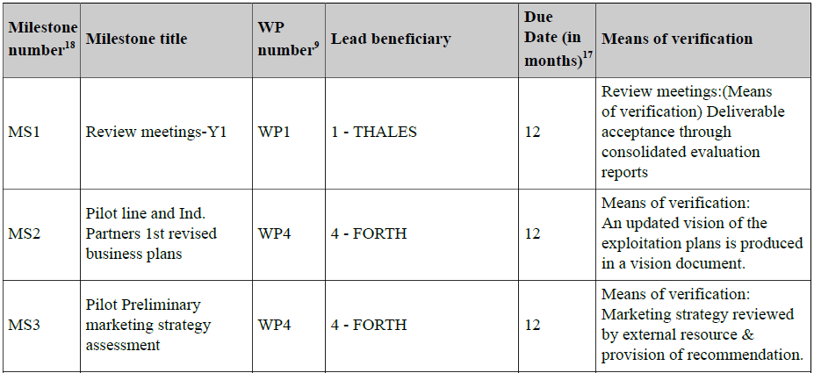
WP1 : Project Management
Status of milestones at M12

Slide 9
WP1 : Project Management
Meetings during the first period
4 general meetings (including Kick of Meeting)
6 technical meetings
Several technical meetings delayed or cancelled due to Covid-19
2nd general meeting postponed from April 2020 to July 2020
Meeting at Palaiseau (THALES) with CIDETE for TEC qualification : cancelled
Meeting at Crete (FORTH) with THALES for Pilot Line implementation : cancelled

Slide 10
WP1 : Project Management
Meetings during the first period
“General”

Slide 11
WP1 : Project Management
General Meetings during first period
Kick of Meeting (all partners were represented)
on 2019 September 17th & 18th
At Santa Cruz de Tenerife in Spain (Host Partner : CIDETE)
Overview of the project (Administrative, technical, business objectives)
Presentation of each partners and their role in the project
Presentation of each Work package by their lead beneficiary
Technical discussions to start the interactions between partners and establish a roadmap according the Gantt chart from DoW
Presentation of the first version of SMARTEC website (https://project-smartec.com/) and choice of the logo for the project

Slide 12
WP1 : Project Management
General Meetings during first period
Kick of Meeting
Representatives for general assemblies ➔ 4 meetings per year
Organization |  | General Assemble Representatives
1 | THALES | Afshin ZIAEI
2 | CIDETE | German NORIEGA
3 | RFM | Hamza EL GHANNUDI
4 | FORTH | George KONSTANTINIDIS
5 | TAIPRO | Bruno HEUSDENS

Slide 13
WP1 : Project Management
General Meetings during first period
Kick of Meeting
WP leaders have been namely identified ➔ Executive Board (2 meetings per year)
Work Packages | WP Leaders
WP1 : Project Management | THALES | Afshin ZIAEI
WP2 : SMARTEC Pilot Line | FORTH | George KONSTANTINIDIS
WP3 : Prototyping | RFM | Paolo FARINELLI
WP4 : Marketing & Business Development | CIDETE | German NORIEGA
WP5 : Ethics requirements | THALES | Afshin ZIAEI

Slide 14
WP1 : Project Management
General Meetings during first period
First general meeting (all partners were represented)
on 2020 January 21st & 22nd
At Liege in Belgium (Host Partner : TAIPRO)
Presentation of work done in each work package between T₀ and T₀+6 : administrative, dissemination, implementation of Pilot Line at FORTH …
Second general meeting (all partners were represented)
Initially planed on 2020 April 28th & 29th at Perugia in Italy (Host partner : RFM)
Meeting delayed because of COVID-19 ➔ On 2020 July 10th online
Discussions about the work done during last period and the impact of the sanitary crisis on partners activities and on SMARTEC project
TRT has been the most impacted (TRT closed and/or partial activity) ➔ impacting all partners. The other partners have been impacted at different levels

Slide 15
WP1 : Project Management
General Meetings during first period
Third general meeting (all partners were represented)
On 2020 October 1st online
Presentation of work done in each work package since last general meeting
Preparation of the review meeting : inputs needed from each partner to each work package leader and to project coordinator
Status of deliverables/Milestones for the first period

Slide 16
WP1 : Project Management
Meetings during the first period
“Technical”

Slide 17
WP1 : Project Management
Technical Meetings during first period
First technical meeting (all partners were represented)
On 2019 November 5th by phone call
Feedback and validation of technical decisions took during the Kick of Meeting
Confirmation that consortium agreement has been signed by all partners
Second technical meeting (all partners were represented)
On 2019 November 26th by phone call
Round of table where each partner has presented its needs or remarks
Trial run fabrications have been started at FORTH

Slide 18
WP1 : Project Management
Technical Meetings during first period
Third technical meeting (THALES & CIDETE)
On 2020 February 12nd by phone call
Discussions on TEC design and axes of improvement for the project need
Fourth technical meeting (all partners were represented)
On 2020 February 20th by phone call
Checking of actions decided during the first general meeting and identification of potential issues
Each WP leader has presented the work progress in their work package

Slide 19
WP1 : Project Management
Technical Meetings during first period
Fifth technical meeting (THALES & TAIPRO)
On 2020 March 12nd by phone call
Discussion on packaging specifications for MEMS RF
Decision of packaging assessment of RF MEMS with TAIPRO means ➔ trial runs
Sixth technical meeting (THALES & FORTH)
On 2020 July 30th by phone call
Review of the 2 set of masks for the 1st run fabrication of SMARTEC

Slide 20
WP1 : Project Management
Costs statement at M12

Slide 21
WP1 : Project Management
Costs statement at M12
Remind of project budget (Duration : 36 months)
PMs
Partners |  | WP1 | WP2 | WP3 | WP4 | WP5 | Total
1 | TRT | 12 | 20 | 29 | 25 | - | 86
2 | CIDETE | 4 | 37 | 18 | 40 | - | 99
3 | RFM | 2 | 9 | 12 | 14 | - | 37
4 | FORTH | 4 | 82 | 4 | 40 | - | 130
5 | TAIPRO | 1 | 12 | 20 | 5 | - | 38
Total |  | 23 | 160 | 83 | 124 | - | 390
Costs
Partners |  | Direct personnel costs | Direct costs of subcontracting | Other costs | Indirect costs | Total costs
1 | TRT | 787 072 | 0 | 80 000 | 216 768 | 1 083 840
2 | CIDETE | 743 000 | 0 | 180 000 | 230 750 | 1 153 750
3 | RFM | 181 594 | 0 | 22 950 | 51 136 | 255 680
4 | FORTH | 350 000 | 35 000 | 279 000 | 157 250 | 821 250
5 | TAIPRO | 241 000 | 0 | 26 000 | 66 750 | 333 750
Total |  | 2 302 666 | 35 000 | 587 950 | 722 654 | 3 648 270

Slide 22
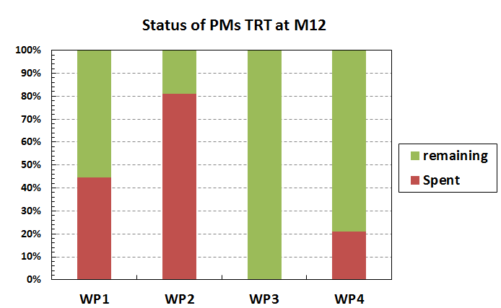
WP1 : Project Management
Costs statement at M12
Status of PMs and costs per partner & per WP THALES
26,83 PMs have been spent during Year 1
The total costs spent during first period is 220 000 € on 1 083 840 € planed for all duration of project ➔ 20% spent
WPs | PMs for all project | Spend at M12 |  | Remaining
WP1 | 12 | 5.366 | (45 %) | 6.634 | (55 %)
WP2 | 20 | 16.22 | (81 %) | 3.78 | (19 %)
WP3 | 29 | 0 | (0 %) | 29 | (100 %)
WP4 | 25 | 5.244 | (21 %) | 19.756 | (79 %)
WP5 | - | - | - | - | -
Total | 86 | 26.83 | (31 %) | 59.17 | (69 %)

Slide 23
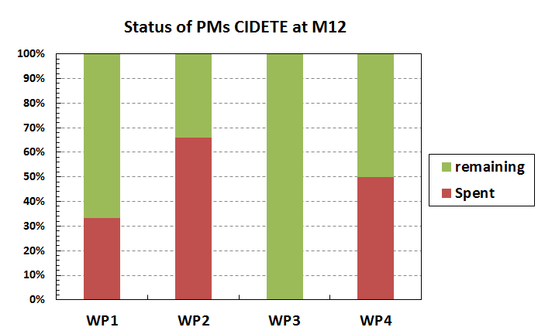
WP1 : Project Management
Costs statement at M12
Status of PMs and costs per partner & per WP CIDETE
45.73 PMs have been spent during Year 1
The total costs spent during first period is 468 029.3 € on 1 153 750 € planed for all duration of project ➔ 41% spent
WPs | PMs for all project | Spend at M12 |  | Remaining
WP1 | 4 | 1.33 | (33 %) | 2.67 | (67 %)
WP2 | 37 | 24.4 | (66 %) | 12.6 | (34 %)
WP3 | 18 | 0 | (0 %) | 18 | (100 %)
WP4 | 40 | 20 | (50 %) | 20 | (50 %)
WP5 | - | - | - | - | -
Total | 99 | 45.73 | (45.73 %) | 53.27 | (54 %)

Slide 24
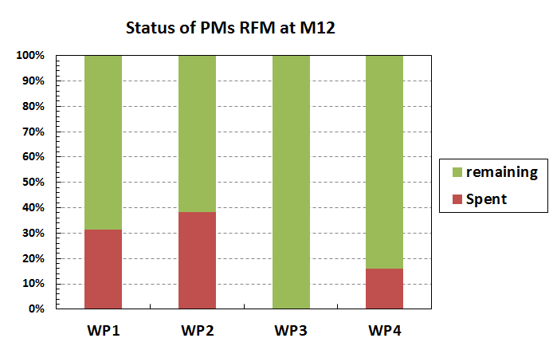
WP1 : Project Management
Costs statement at M12
Status of PMs and costs per partner & per WP RFM
6.33 PMs have been spent during Year 1
The total costs spent during first period is 43 453.513 € on 255 680 € planed for all duration of project ➔ 17 % spent
WPs | PMs for all project | Spend at M12 |  | Remaining
WP1 | 2 | 0.63 | (32 %) | 1.37 | (69 %)
WP2 | 9 | 3.45 | (38 %) | 5.55 | (62 %)
WP3 | 12 | 0 | (0 %) | 12 | (100 %)
WP4 | 14 | 2.25 | (16 %) | 11.75 | (84 %)
WP5 | - | - | - | - | -
Total | 37 | 6.33 | (17 %) | 30.67 | (83 %)

Slide 25
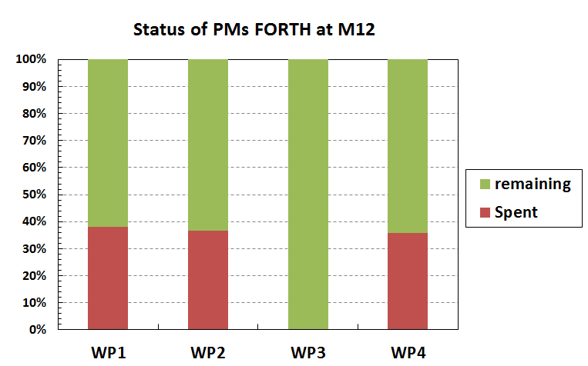
WP1 : Project Management
Costs statement at M12
Status of PMs and costs per partner & per WP FORTH
46.01 PMs have been spent during Year 1
The total costs spent during first period is 233 661.98 € on 821 250 € planed for all duration of project ➔ 28 % spent
2 new hires at FORTH thanks to SMARTEC project
Loukas MICHALAS (MEMS-RF)
Manos TRICHAS (Marketing & business)
WPs | PMs for all project | Spend at M12 |  | Remaining
WP1 | 4 | 1,52 | (38 %) | 2,48 | (62 %)
WP2 | 82 | 30,11 | (30.11 %) | 51,89 | (63 %)
WP3 | 4 | 0 | (0 %) | 4 | (100 %)
WP4 | 40 | 14,38 | (36 %) | 25,62 | (64 %)
WP5 | - | - | - | - | -
Total | 130 | 46.01 | (35 %) | 83.99 | (65 %)

Slide 26
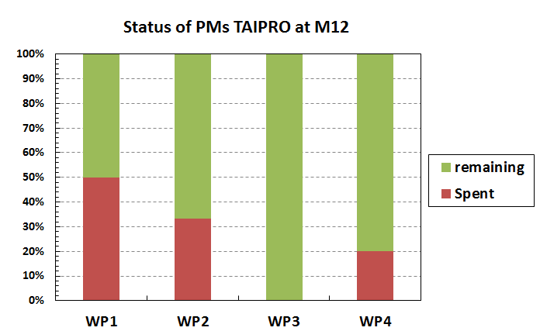
WP1 : Project Management
Costs statement at M12
Status of PMs and costs per partner & per WP TAIPRO
5.5 PMs have been spent during Year 1
The total costs spent during first period is 38 487.25 € on 333 750 € planed for all duration of project ➔ 12 % spent
WPs | PMs for all project | Spend at M12 |  | Remaining
WP1 | 1 | 0.5 | (50 %) | 1.37 | (69 %)
WP2 | 12 | 4 | (33 %) | 5.55 | (62 %)
WP3 | 20 | 0 | (0 %) | 12 | (100 %)
WP4 | 5 | 1 | (20 %) | 11.75 | (84 %)
WP5 | - | - | - | - | -
Total | 38 | 5.5 | (14 %) | 32.5 | (86 %)

Slide 27
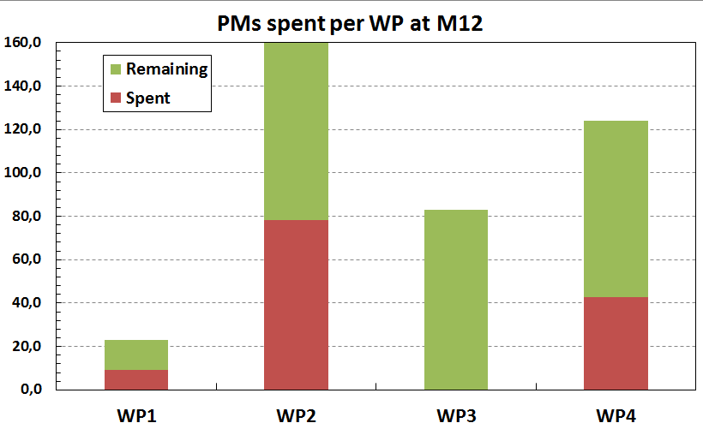
WP1 : Project Management
Costs statement at M12
Overview PMs spent on SMARTEC per WP
130.4 PMs have been spent during Year 1 ➔ 33 % PMs spent
WP1 T₀ to T₀+36 ➔ 41 % spent
WP2 from T₀ to T₀+24 ➔ 49 % spent
WP3 will start at M18 ➔ 0 % spent
WP4 from T₀+6 to T₀+36 ➔ 35 % spent
WPs | PMs for all project | PMs Spend at M12 |  | Remaining
WP1 | 23 | 9.35 | (41 %) | 13.6 | (59 %)
WP2 | 160 | 78.18 | (49 %) | 81.8 | (51 %)
WP3 | 83 | 0 | (0 %) | 83 | (100 %)
WP4 | 124 | 42.87 | (35 %) | 81.1 | (65 %)
WP5 | - | - | - | - | -
Total | 390 | 130.4 | (33 %) | 259.6 | (66.5 %)

Slide 28
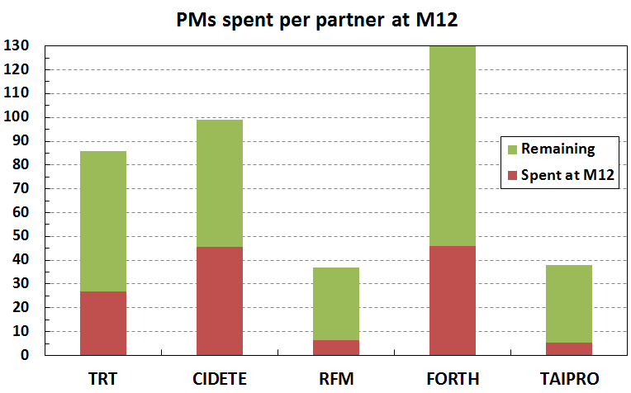
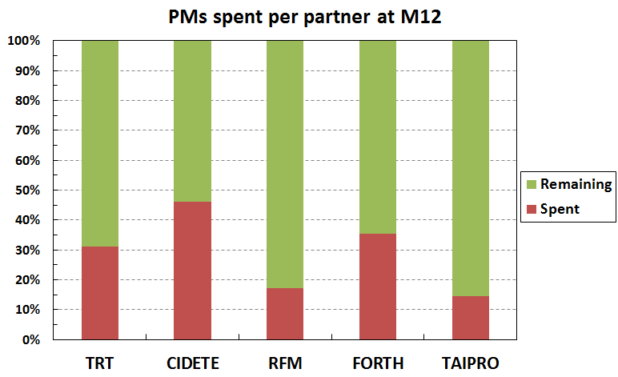
WP1 : Project Management
Costs statement at M12
Overview PMs spent on SMARTEC per partner
FORTH has its main efforts in WP2 (ending at M24)
RFM has its main efforts in WP3 (M18) and WP4 (started at M6)
TAIPRO has its main efforts in WP3 (M18)

Slide 29
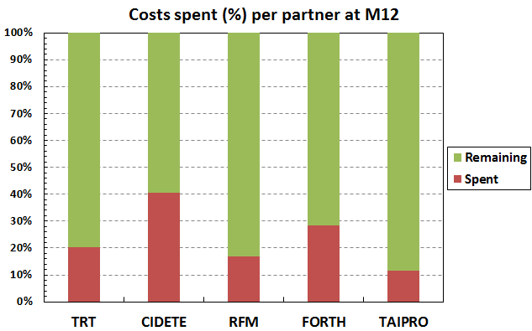
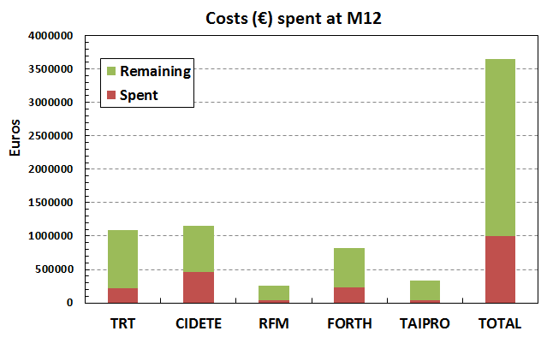
WP1 : Project Management
Costs statement at M12
Overview of total costs spent on SMARTEC project
Partner | Costs for all project | Spend at M12 |  | Remaining
TRT | 1,083,840 | 220,000 | (20 %) | 863,840 | (80 %)
CIDETE | 1,153,750 | 468,029.3 | (41 %) | 685,720.7 | (59 %)
RFM | 255,680 | 43,453.51 | (17 %) | 212,226.49 | (83 %)
FORTH | 821,250 | 233,661.98 | (28 %) | 587,588.02 | (72 %)
TAIPRO | 333,750 | 38,487.25 | (12 %) | 295,262.75 | (88 %)
Total | 3,648,270 | 1,003,632 | (28 %) | 2,644,637.96 | (72 %)
TOTAL

